Slide 1
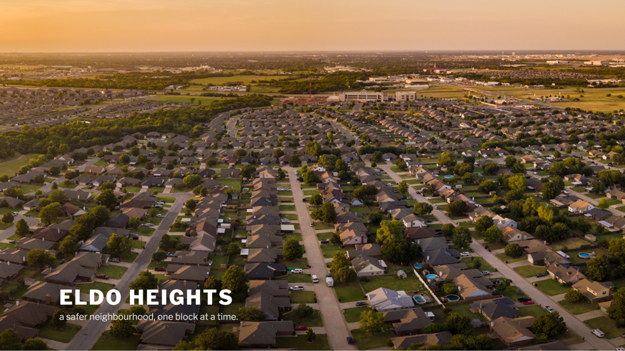
COORDINATORS
MEETING
FEB 2020

Slide 2
Agenda
06
Requirements
Janus van Zyl – 5 min
01
Welcome & Thanking
07
Timeline / Project Plan
Adriaan Goosen – 5 min
Janus van Zyl – 5 min
02
Orientation & Background
08
Finances
Adriaan Goosen – 5 min
Callie Pieterse – 10 min
03
Steps Complete
09
Comms Plan
Adriaan Goosen – 5 min
Simon Wilkinson – 10 min
04
Safety Stats
10
Your Involvement (Volunteers)
Bertus Myburg – 10 min
Vaughn Miller – 5 min
05
Testimonial
11
Committee Vote
Jacques Roberts – 10 min
Adriaan Goosen

Slide 3
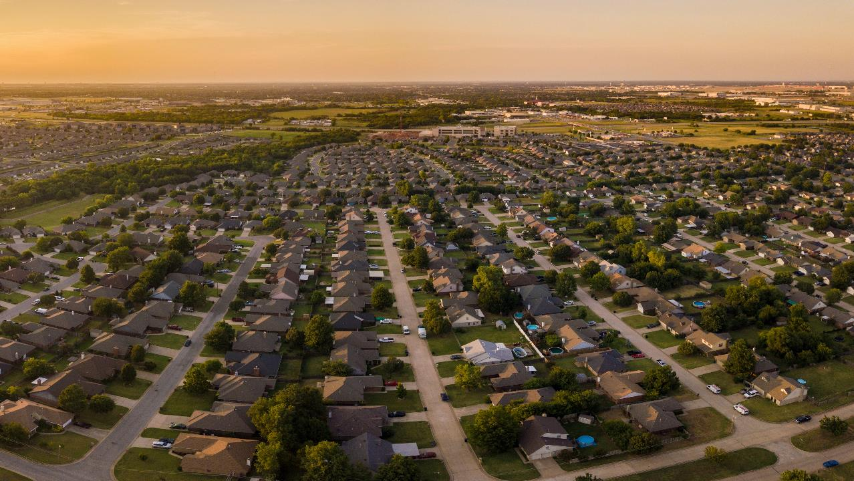
`
Unless the Lord builds the house, the builders labour in vain. Unless the Lord watches over the city, the guards stand watch in vain.”
Psa 127

Slide 4
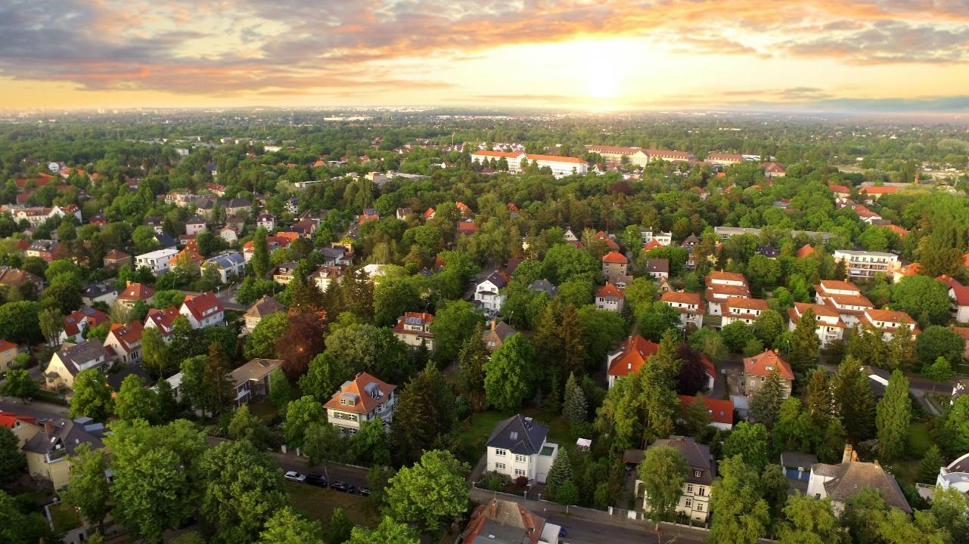
Background
And
Orientation
Adriaan Goosen

Slide 5
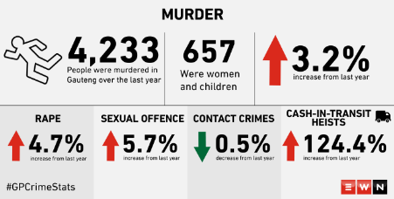
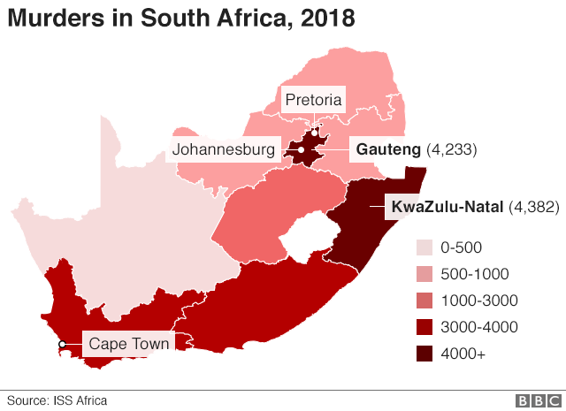

BACKROUND
CRIME
PROPERTY VALUE
SAFE COMMUNITY

Slide 6
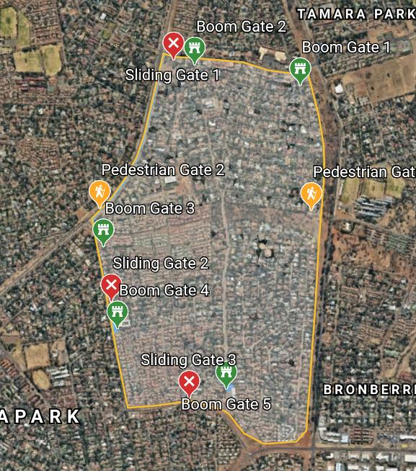
5 x Boomed Gates
3 x Sliding Gates
2 x Pedestrian Gates
ClearVu Fencing

Slide 7
Area Include:
COMPLEX | STREET
Eldo 3 Manor | Aalwyn Cres | Ewald Road | Kort Street | Soetdoringdraai Street
Frizzante | Anthill Cres | Fitzgelrald Street | Little Lane | Springbok Street
Henri Place | Baobab Street | Frederik Avenue | Lyell's Lane | Suni Nook
Ilanda Place | Blue Gum Bend | Garnet Street | Marinus Road | Swart Street
Ireland Gardens | Brendon Pl | Guineafowl Walk | Mulder's Mile | Tanyas Terrace
Ireland Heights | Caley Street | Henri Road | Plover's Path | Weavind Ave
Ireland Hills | Colleen Nook | Ingrid's Isle | Quiet Cl | Wilhelm Road
Ireland Park | Die Koppie Street | Ireland Avenue | Rene's Road | Willem Road
Ireland Place | Die Uitsig Road | Justin Cres | Roan Nook | Will's Way
Justin Villas | Drienie Street | Koedoe Street | Shamrock Nook | Winston Road
Mardine Park | Edwards Road | Koos Smal Road | Shirley Road | Wynne Road
Maritane
Swallow's Nest
Uitsig Park
STREETS = 47
COMPLEXES = 24
BUSINESSES = 84
CHURCES = 4

Slide 8
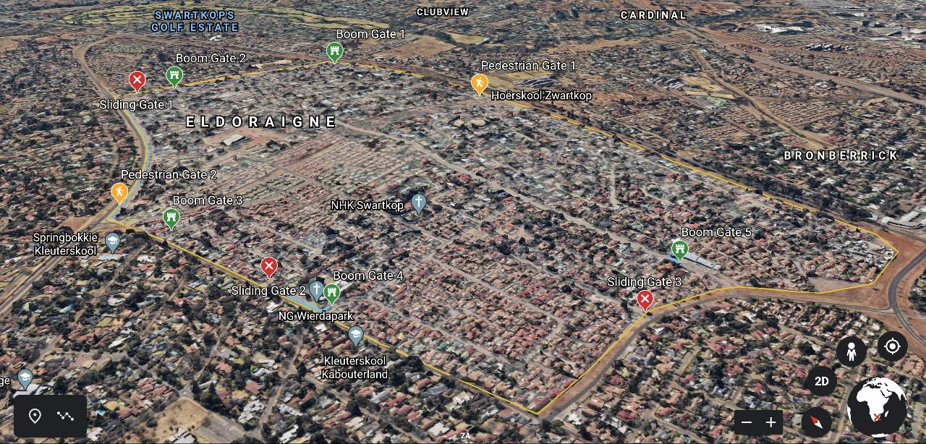
https://drive.google.com/open?id=1r6NkWkwMd6U18MnP1EHAQa3w0ig2cK4-&usp=sharing

Slide 9
Steps Complete
Adriaan Goosen

Slide 10


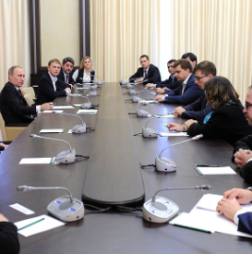

02
04
2019-12-11
2020-02-10
First formal Committee meeting
Agreement on name to be used: ELDO HEIGHTS
Compile action plan with responsibilities to each member
Communication Strategy Compiled
First meeting for 2020 arranged with Eldo Heights Representatives / Volunteers
01
03
2019-11-27
First meeting at Eldoraigne Library to share idea of closing a portion of Eldoraigne
Recommendation to arrange a follow-up meeting with broader area representatives
2020-02-05
Strategic Partners Selected
  Streetsafe - PM
  Pexton Cerva – Admin Process
Final approval of area to be enclosed
Updated cost estimates reviewed
2019-12-11
Support confirmed to proceed with initiative
Temporary Committee Appointed

Slide 11
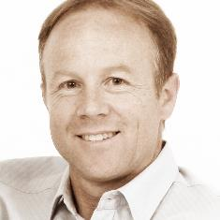
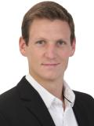
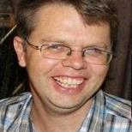
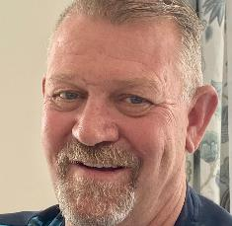

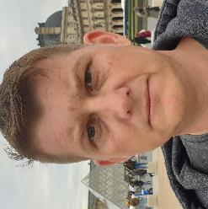
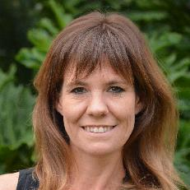
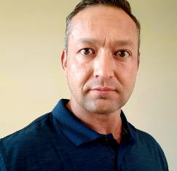
Adriaan Goosen
Vaughn Miller
Callie Pieterse
Mark Laros
CHAIRPERSON
VICE CHAIRPERSON
FINANCIAL OFFICER
HEAD OF SECURITY
Simon Wilkinson
Janus van Zyl
COMMUNICATION OFFICER
Michelle Wilkinson
CONSTRUCTION MANAGER
ADMINISTRATOR

Slide 12
Safety Statistics
Bertus Myburg

Slide 13

Providing a complete security solution, by integrating traditional security services with the latest technologies.

Slide 14


Copwatch
Background
Operational for more than 20 years
in the Centurion Area
SAIDSA Accredited Armed Response and Control Room
Office situated in Zwartkop
Established client base in the Area
Good working relationship with CPF and Community Role players

Slide 15
Crime Stats
Total number of Incidents reported
    January 2019 to 12 February 2020 = 337

Slide 16
    Total Eldoraigne = 39
    Contributing = 11,5% (Client Bias)
    January 2019 to 12 February 2020 = 337

Slide 17
Crime Stats
Total number of Incidents reported from January 2019 to 12 February 2020 = 337
Total Eldoraigne = 39
Contributing = 7,9% (Client Bias)
Total Eldo 3 = 0 reported incidents/ Boomed off Area
Total Eldo Heights = 26
Contributing = 7,7% / 86% Eldoraigne

Slide 18

Modus Operandi for Residential Break in
Targeting of gate motors and gates.
Secure Gate against lifting
Secure gate motor against tampering
Fit Gate sensor to start stopwatch early
Targeting of Front door and Security gate
Reinforce Front door and security gate
Once gate and front door are breached TV room and main bedroom targeted

Slide 19
Testimonials

Slide 20
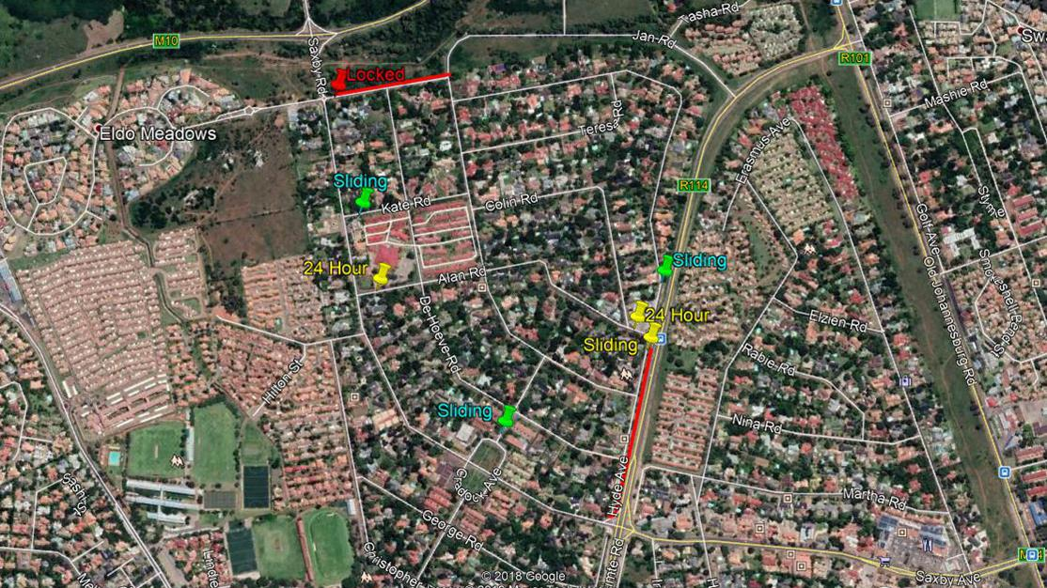
Eldoraigne 1 Security Village

Slide 21
Requirements
Janus van Zyl

Slide 22

Council Requirements
67% (70%) Support by Owners
Traffic impact study
Formal application
Application fee paid
All departments to approve
SLDT to provide principal approval
40 Days advertising for objections
Comply to 58 requirements – way leave approval
2 Yearly reapplication

Slide 23
Timeline
And
Project Plan
Janus van Zyl

Slide 24


Projected Timeline
Apr - Jul 2020
Aug - Oct 2020
Support & Funding
Study & Application
Obtain 70% support in principle and funding for the application.
Conduct a traffic impact study and submit with the application to the council. The application fee also need to be paid at submission.

Slide 25



Nov ‘20 – May ‘21
Jun ‘21
Aug – Oct ‘21
Review
Approval
Construction
All city council departments are required to review and approve.
Advertising of objectives is done during this time frame.
The Council grants approval of the application and construction may commence.
The construction of the gates, fences and required infrastructure will happen in this period.

Slide 26
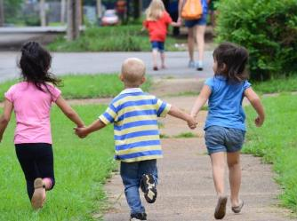
End of Timeline
1
Nov ‘21
Operational
The start of a new safer beginning when Eldo Heights becomes a reality.

Slide 27
Finances
Callie Pieterse

Slide 28

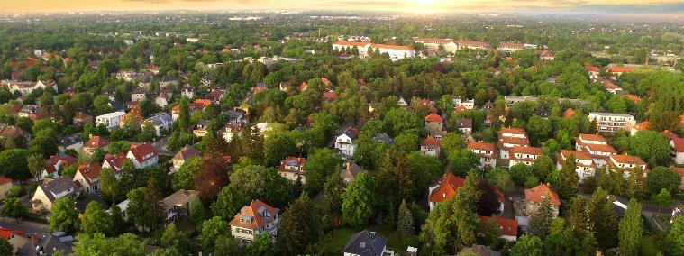
Project plan
Participation
Every journey begins with a first step.

Slide 29
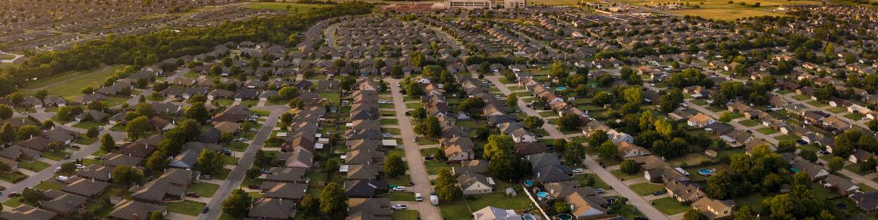
What, Where, When and Who
What will the boomed area look like?
Area that needs to be covered?
When will it be done?
Who will do it?
The other variable that one needs to consider is who will participate with this project?

Slide 30

Phase 1 - R120,000
Phase 2 - R850,000
Phase 3 - R5,500,000
Phase 4 - xxxxx
Phase 1 – Preparation
Phase 2 – Approval
Phase 3 – Construction
Phase 4 – Maintain

Slide 31
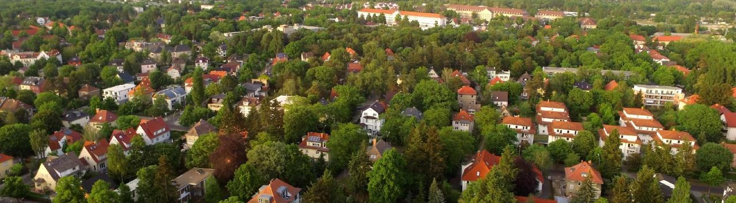
Participation estimated on 70% which equates to:
636 houses
Duettes
Townhouses
Phase: | Houses | Duettes | Townhouses
Phase 1 + 2 | R 1,600 | R 800 | R 400
Phase 3 | R 9,000 | R 4,500 | R 2,300

Slide 32
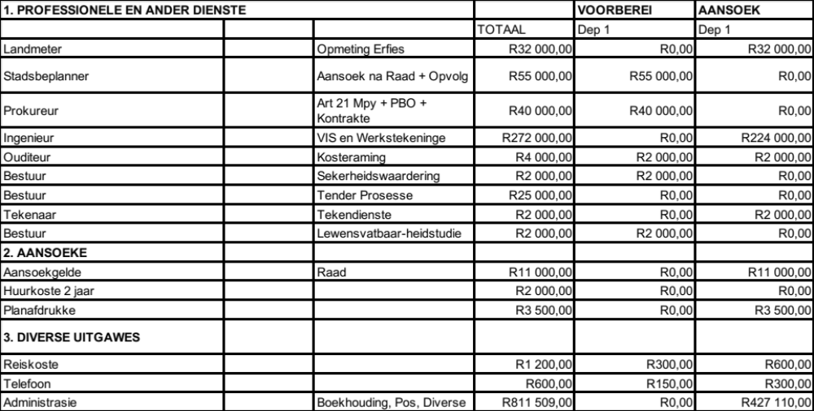
NB - Cost estimates based on tenders received by Streetsafe for latest 3 Gated Initiatives in Pretoria

Slide 33
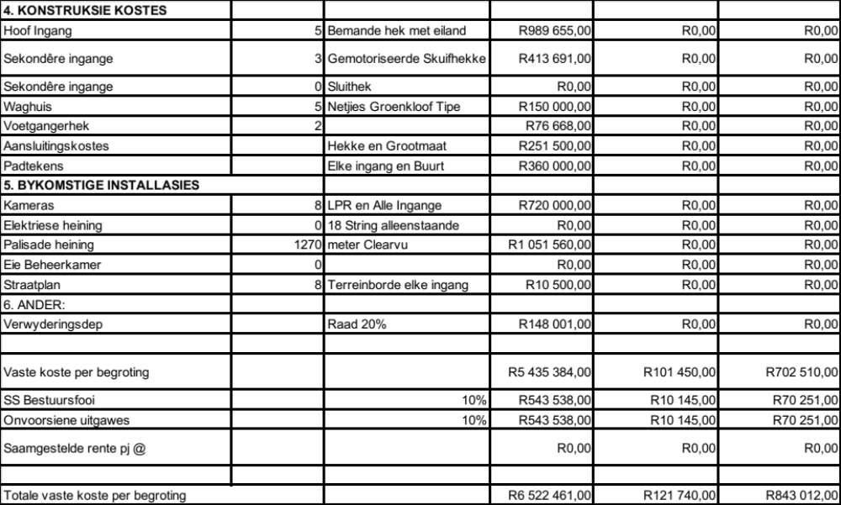
NB - Cost estimates based on tenders received by Streetsafe for latest 3 Gated Initiatives in Pretoria

Slide 34
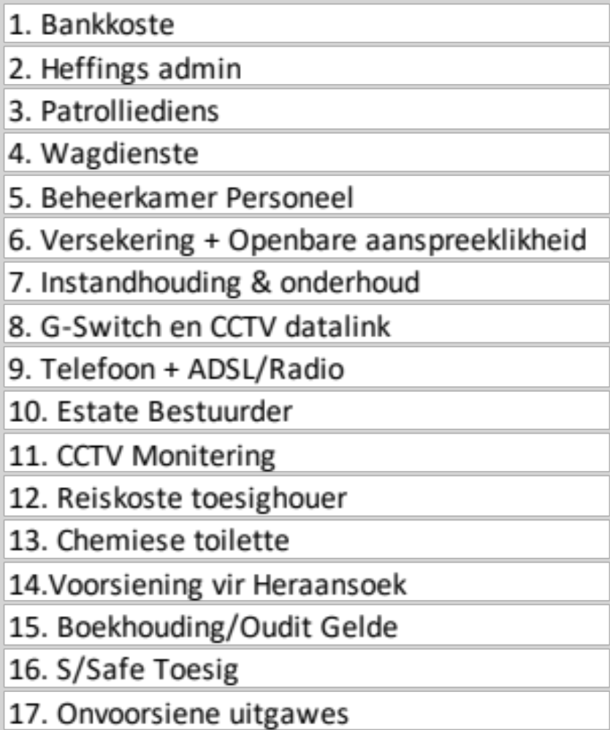
Phase 4 - Maintenance Cost (Monthly Levies)
Estimates based on tenders received by Streetsafe for latest 3 Gated Initiatives in Pretoria
Estimates based on 70% participation and can reduce if more residents commit to monthly cost
Cost is inclusive of Community as well as individual Residential armed response
Per House | Per Duette | Per Townhouse
R760 | R415 | R250

Slide 35
Communication
Plan
Simon Wilkinson

Slide 36

Communications
Objectives
Drive awareness
Educate stakeholders about the process and time framing, detailing milestones and commitment requirements
Highlight strategic initiatives demonstrate share value outside of safety
  Economies or scale (group buying)
  Community lifestyle
Identify and recognise ambassadors to help support the message
Street captains /Business sponsors
Complete transparency with Planning / process and finances
Measure reach / adoption and drive financial commitment

Slide 37

Landing the message
The Why
The Support
The How
The What
What’s in it for me

Slide 38
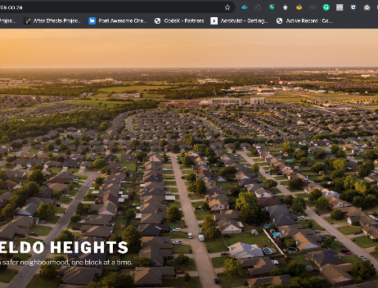


Support Channels
Notes:
Toolkit:
1.Onboarding
a. Training
b. NDA
2.Support Materials
3.Channels Access
a. FAQ's
4.Escalation procedure
5.Insentive
Awareness - Drive attendance

Slide 39
Public Meeting
Complex Entries
Proposed closure locations
Notice boards
Intersections
First Meetings / replaced with digital
Security operators
Real estate agencies
Complex Entries
Proposed closure locations
Press
Digital
Street Captains

Slide 40
Your
Involvement
Vaughn Miller

Slide 41
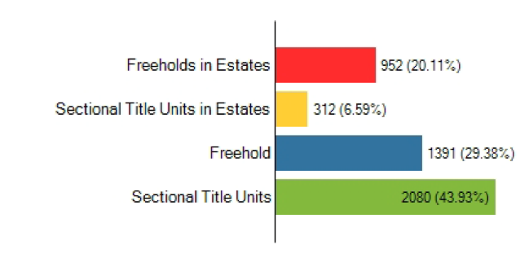
The Why Again
Safety and Security – peace of mind living
Value Increase in our community’s homes and assets

Slide 42
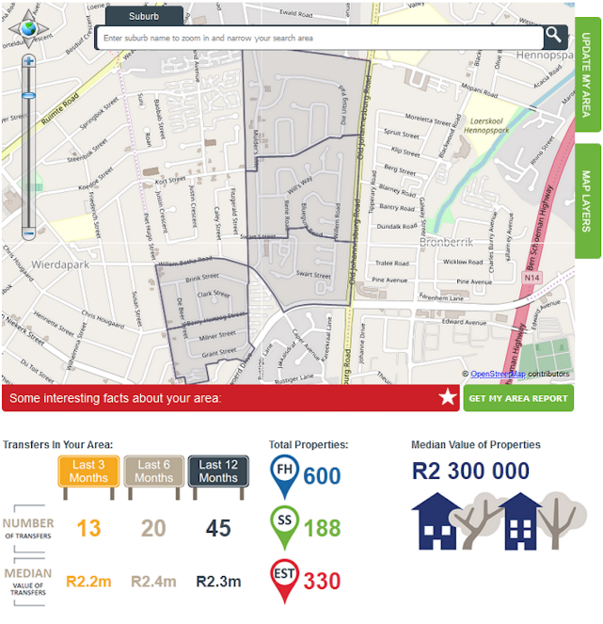
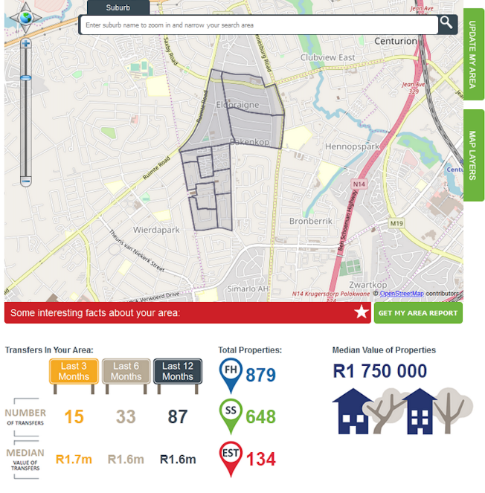

Slide 43
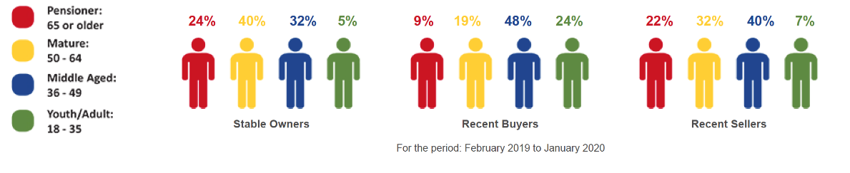
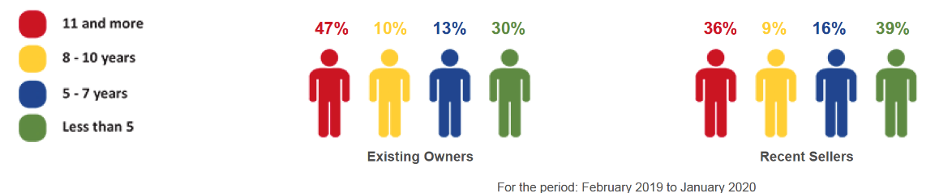
The Audience

Slide 44
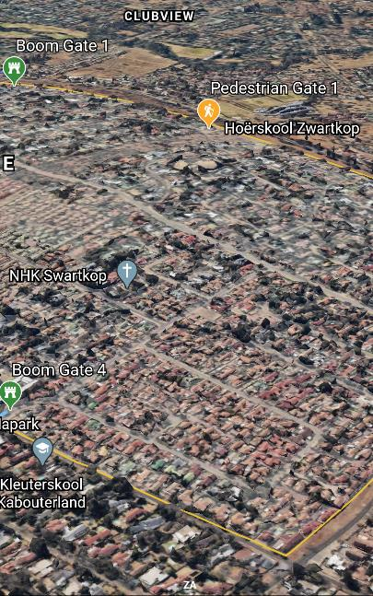


Champion the initiative
What You need to do
Be the primary channel for communication
70% buy-in at least
Pre- Public Participation meeting
Information gathering and handling – UPDATED CONTACT DETAILS
Create a WhatsApp group to broadcast relevant info timeously
Answer FAQ’s and Direct to our Webpage

Slide 45
Continue to Champion the initiative and keep momentum
Assist in the collection of outstanding documents and payments
Get members to download the app
Communicate progress and other relevant updates
What You need to do
70% buy-in at least
Post- Public Participation meeting

Slide 46
New
Committee
Vote
Adriaan Goosen

Slide 47
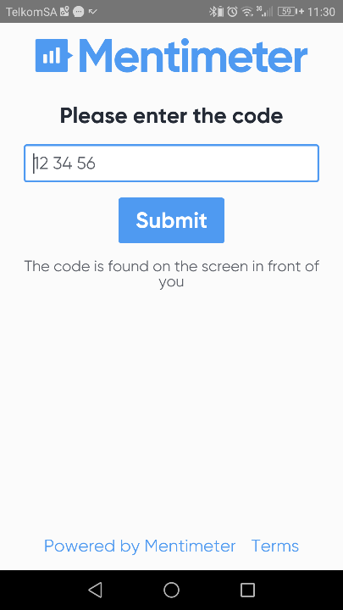
Chairperson
Vice-Chairperson
Committee Admin
Financial Manager
Financial Assistant
Procurement Manager
Procurement Assistant
Communication Manager
Communication Assistant
Security
Security 2nd
Maintenance
Construction
Legal

Slide 48
Thank You
For the attentions

