Slide 1
Eldoraigne -Street Closure Meeting
11 December 2019
Welcome – Adriaan Goosen
Jan Malan - Streetsafe-Security Solution
Do you want us to test support for proposal in Eldoraigne?
Questions
Nominations and Election of Committee
Administration
Closure – Adriaan Goosen

Slide 2


Slide 3
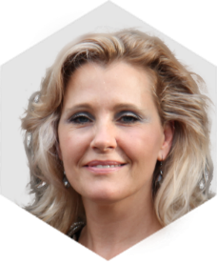
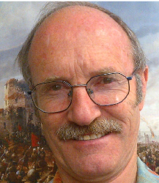
Team
Eldoraigne
Streetsafe
Paxton Cerva
Funding
Admin
Marketing
Contacts
Consulting
Cost Estimates
Application
Contractor Management
Operations
Legal Contracts
Structure
Accounting
NPC Committee
Jan Malan
Wanda Woolf

Slide 4
Systems to Effectively Safeguard
Eldoraigne Central
Colonel (Retired – SA Army)
Jan Malan
0827840807

Slide 5
WHO IS STREETSAFE?
Project Management company
Specializes in neighbourhood- and estate security
One stop solution
Security project management
Established 1998
Responsible for securing Wapadrand, Eldoraigne3, Faerieglen 6, Lynnwood North, Lynnwood Glen, Waterkloof Ridge, Irene, Constantia Park, Brooklyn, Groenkloof etc.
201 throughout Gauteng
New concept and technology for neighbourhood and estate safety and security

Slide 6
Crime Situation in RSA – 2017-18
Violent crime against the person = 33% of South Africa’s recorded serious crime!
13.5% increase in robberies at residential premises (9063, 9351,9391,10173,12761, 14481, 18786,20820, 22261 the past year!)
8 269 carjacking's in 2017/18 in Gauteng!
25 705 car stolen in Gauteng last year! (70,4 per day!)
Reported contact crimes against a person National = 601 366 cases!!

Slide 7
Crime in SAPS Wierdabrug Apr 18-Mar 19
Source: www.saps.gov.za
Murders 4 to 1
Attempted Murder 21 to 29
Assault 61 to 76
Robbery at residential premises 92 to 72
Burglary residential premises 913 to 918
Theft of motor vehicles 489 to 463
Theft out of motor vehicles 895 to 748
Drug related crime 155 to 205
All other theft 992 to 982
Total 14.62 per day!

Slide 8
Robberies at Residential Premises
18:00 – 20:59 - 15.9%
21:00 – 23:59 - 23%
00:00 – 02:59 - 32%
03:00 – 05:59 - 15.5%
First contact inside residence = 87.5%
Forced entry = 67.5% of cases
Most house robberies by small groups of unemployed youths

Slide 9
Carjacking
18:00 – 20:59 - 43.7%
21:00 – 23:59 - 9.8%
00:01 – 04:59 - 9.4%
05:00 – 08:59 - 9.9%
70% at gate of driveways of residences
Theft of Motor Vehicles = 24 321 in Gauteng in 2018/19 !
Theft out of Motor Vehicles = 39 171 in Gauteng past year!

Slide 10
Types of crime experienced in our Neighbourhoods
Mostly violent and not social crimes
Mostly not highly organised syndicates , but smaller groups of 2 – 4 criminals with arms
Residential robberies with fire arms
Carjackings at house gates/garages
Theft of motor vehicles
Theft out of motor vehicles

Slide 11
YOUR CONTRIBUTION:
1. Lock your vehicles and property
2. Keep your eyes open and report immediately
3. Speak to your house residents to be vigilant
4. Rather safe than sorry!
5. Contribute to your neigborhood security initiative

Slide 12
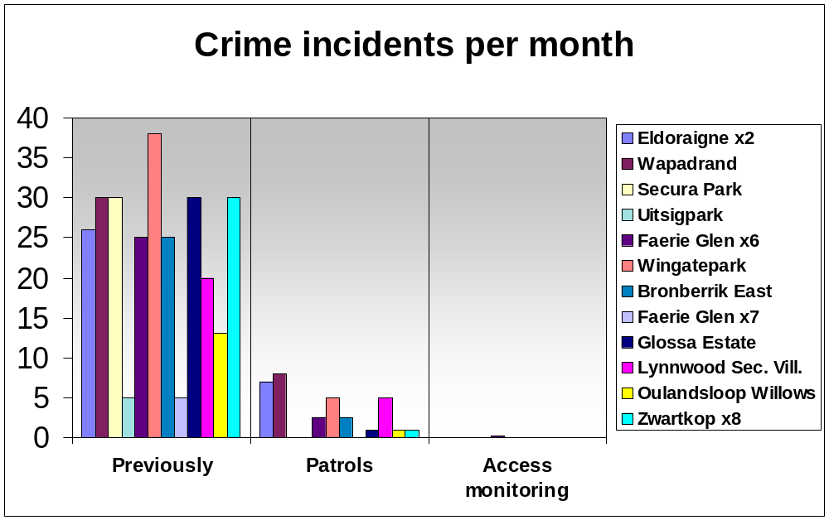
RESULTS

Slide 13
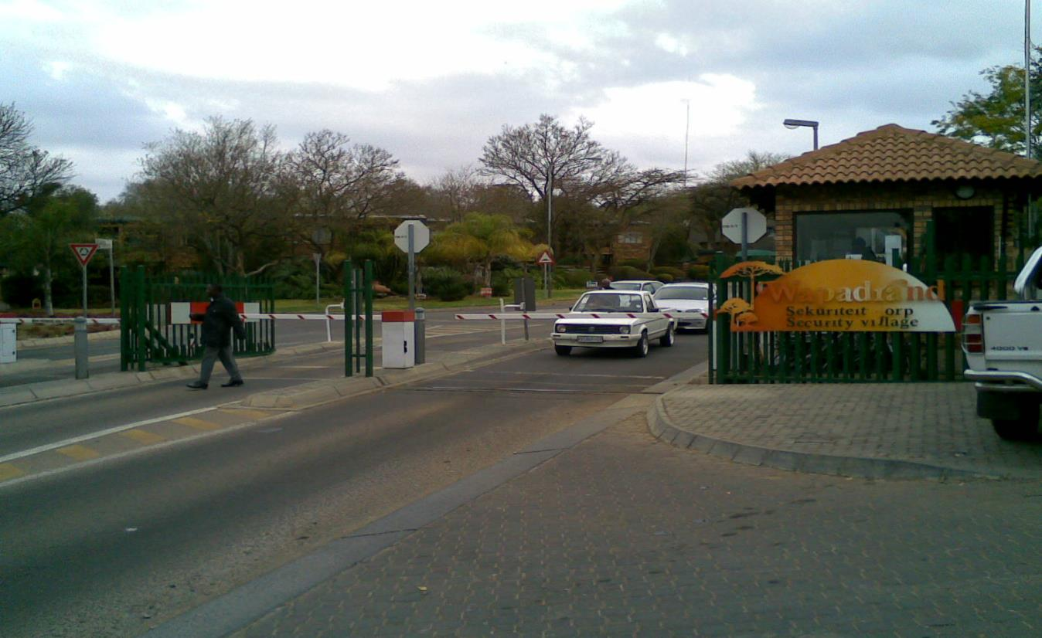
Proof of Effectiveness

Slide 14
EFFECTIVE LOCAL SECURITY
How will we achieve this?
1. Effective outer perimeter protection
2. Excellent entrance monitoring – human element removed
3. 24-hour entrance guards
4. Pro-active patrolling
5. Surveillance
6. Effective supervision
7. Effective management and administration

Slide 15
STREETSAFE SYSTEMS
24 hour Manned Entrances
High Technology Cameras
Remote Operated Sliding Service Gates
Locked Gates
Pedestrian Access
Road Signs & Markings
Estate Management Systems
  Estate Manager, Web sites, sms, email, Paxton database, etc
Monthly Measurement and SLA

Slide 16
NEW ENTRANCE SOLUTION
No discrimination ito age, race, gender
Same solution for vehicles and pedestrians
No guard makes decisions – entrance allowed
Pictures of driver + vehicle + time recorded
Number plates photographed
Booms as traffic calming measure: necessary for control, to get accurate details, to stop criminals, to stop rat-running
Emergency power – for continuity

Slide 17
ENTRANCE SOLUTION (2)
Traffic volumes – 350 vehicles per lane per hour:
  No blockages
  Free thoroughfare
  Emergency and service vehicles uninterrupted
  Higher volume roads = larger areas

Slide 18
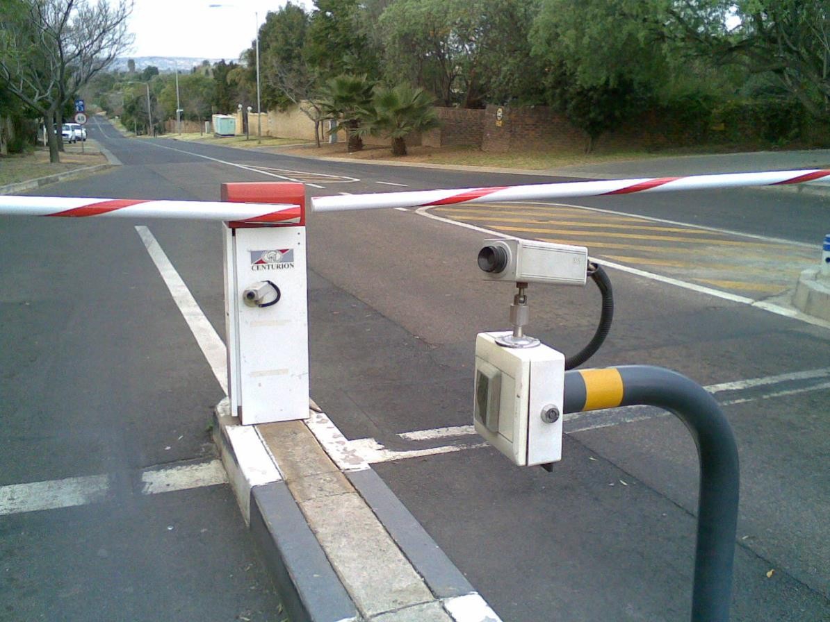
Camera Controlled Enter & Exit

Slide 19
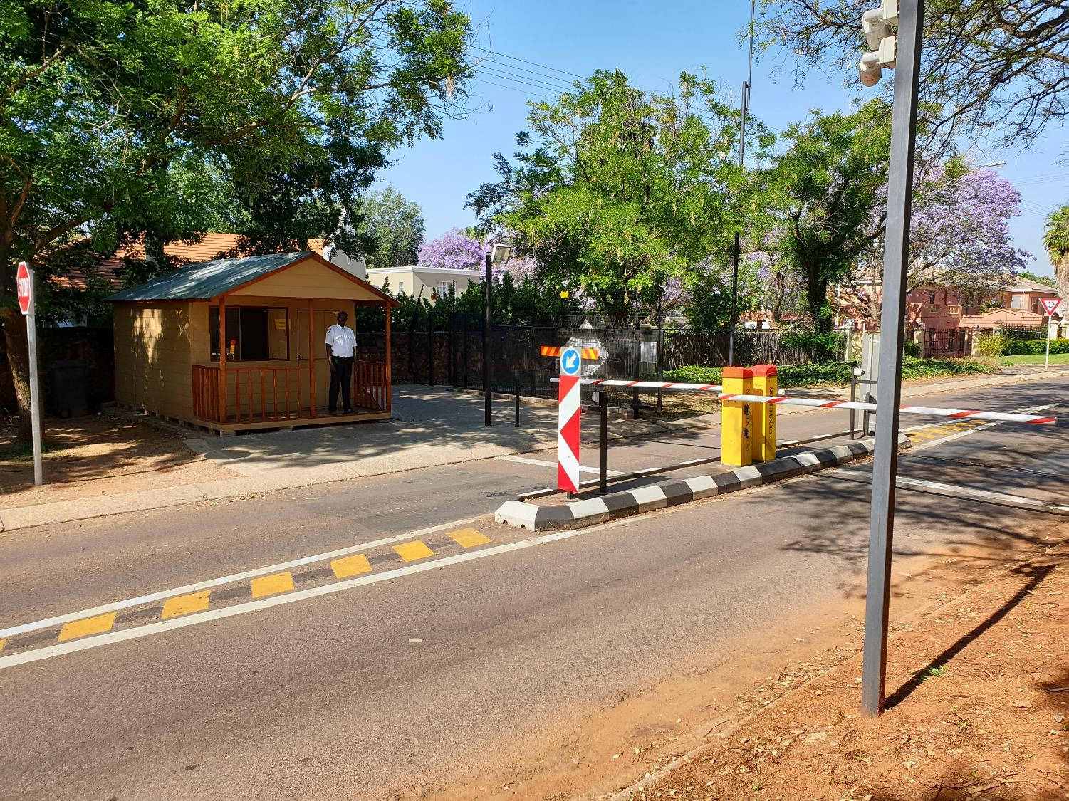

Slide 20
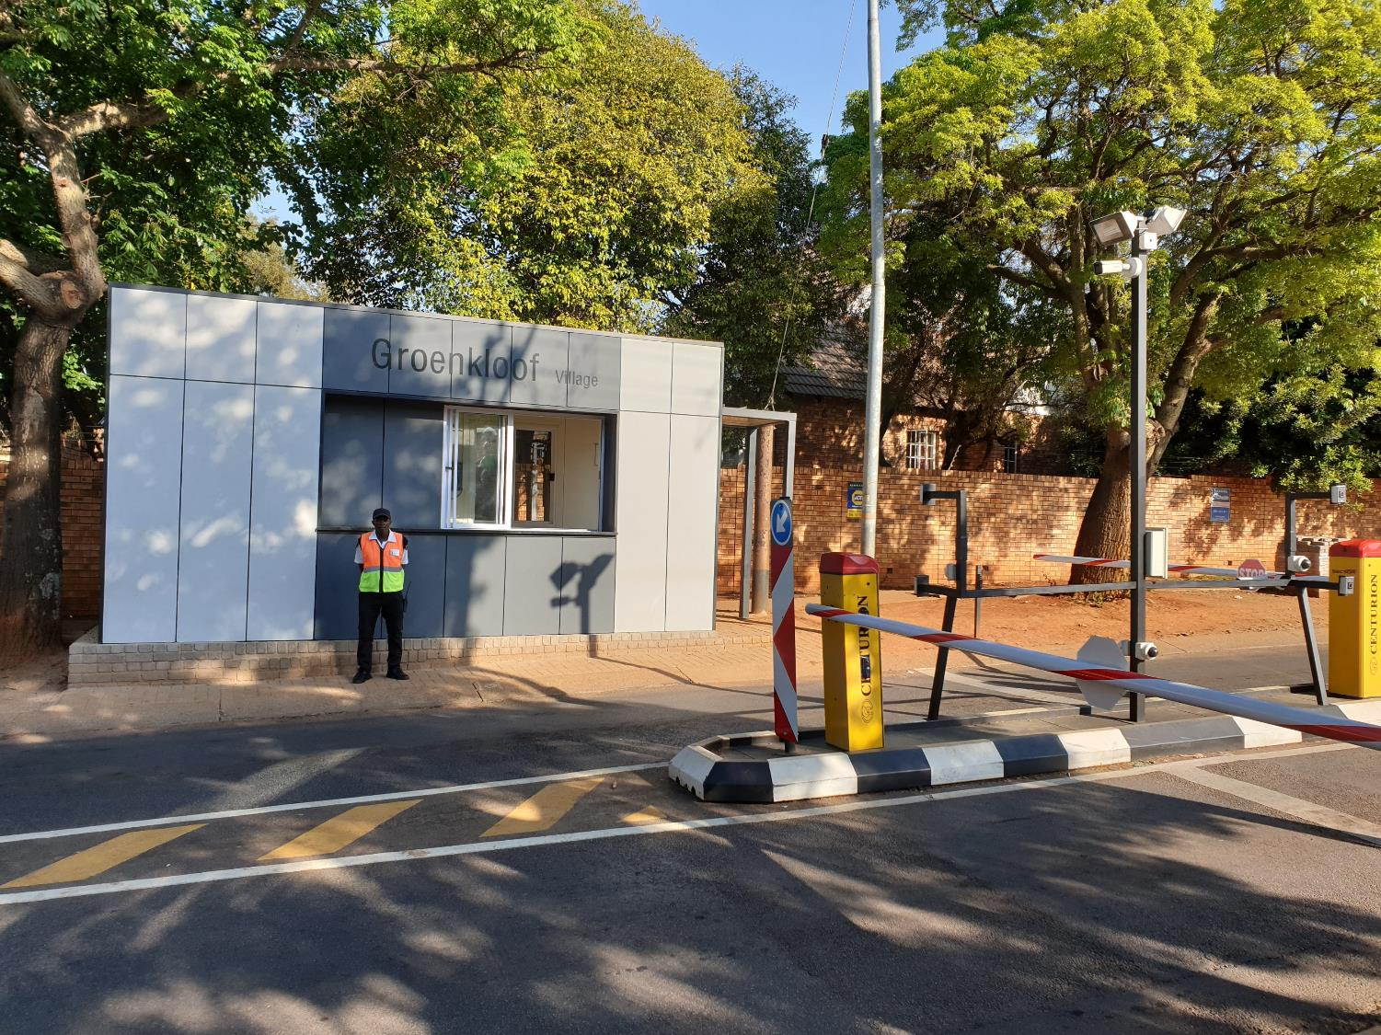

Slide 21
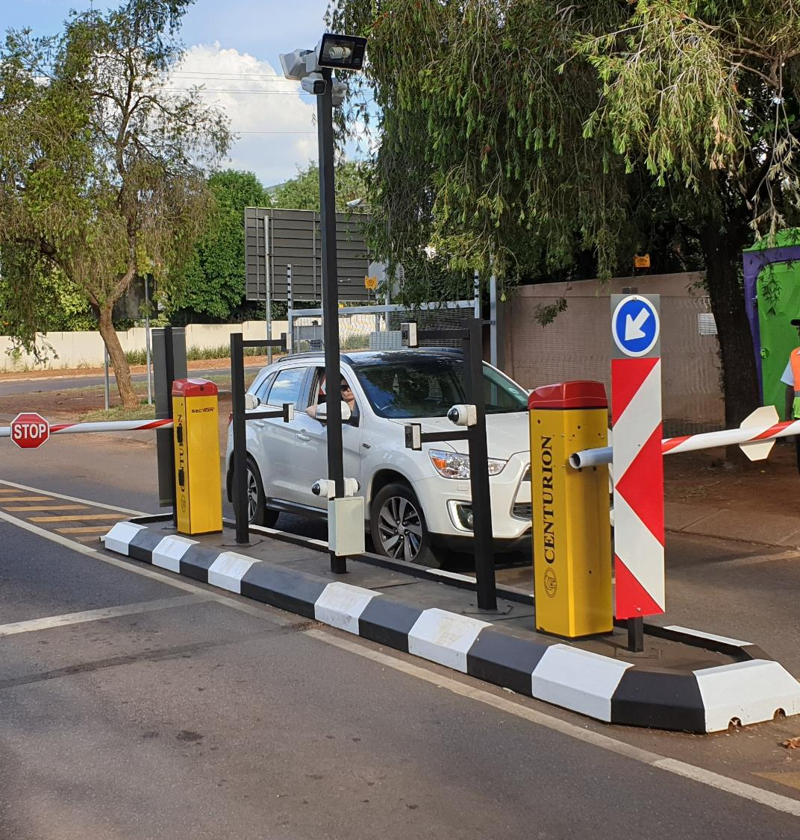

Slide 22
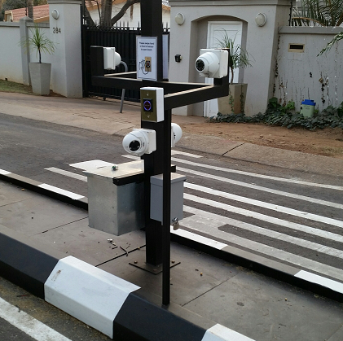

Slide 23
CAMERAS AS AN OPTION
Legal Status of Cameras
Entrance Cameras
Licence Plate Recognition
Pan Tilt & Zoom High Speed Domes
Guard Monitoring
Activity/Movement Detection/Monitoring
Linking to Off-Site Control Rooms

Slide 24
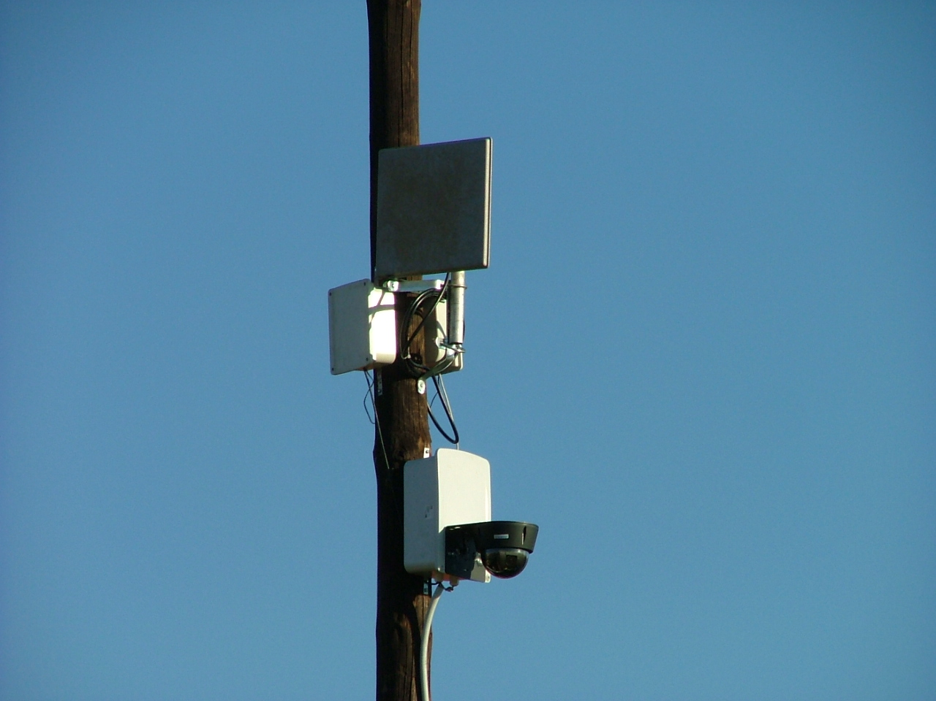

Slide 25

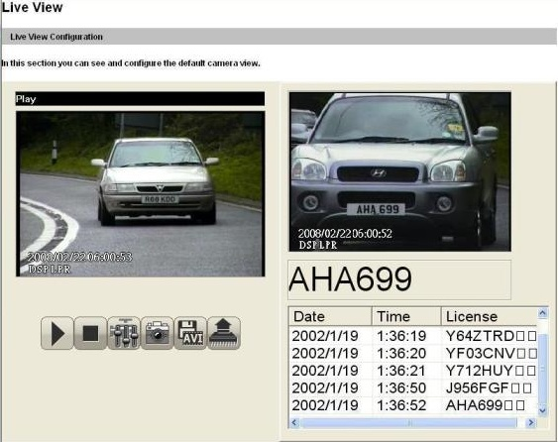
DSP provides Web-interface for Live view
Live View box
Recognized Car plate box
Snap shot
Record as AVI

Slide 26
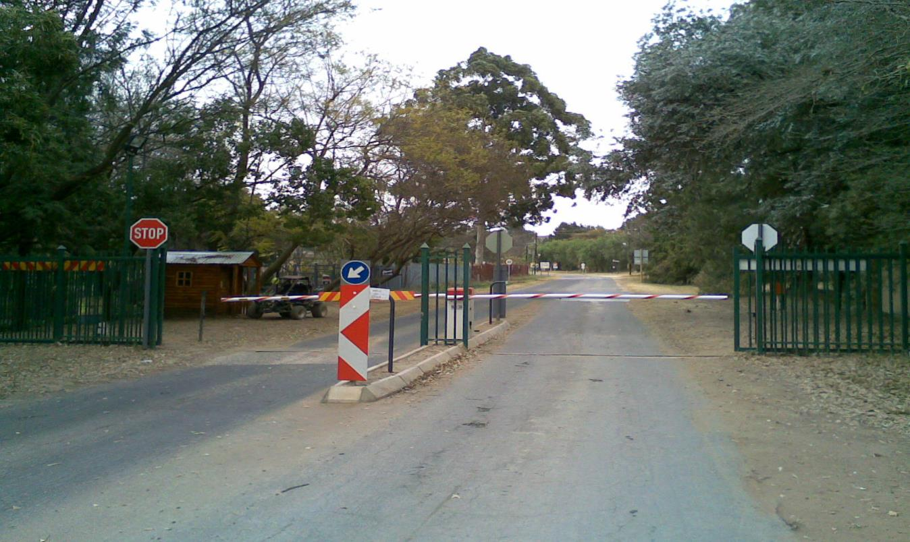
Shere with School & Church

Slide 27
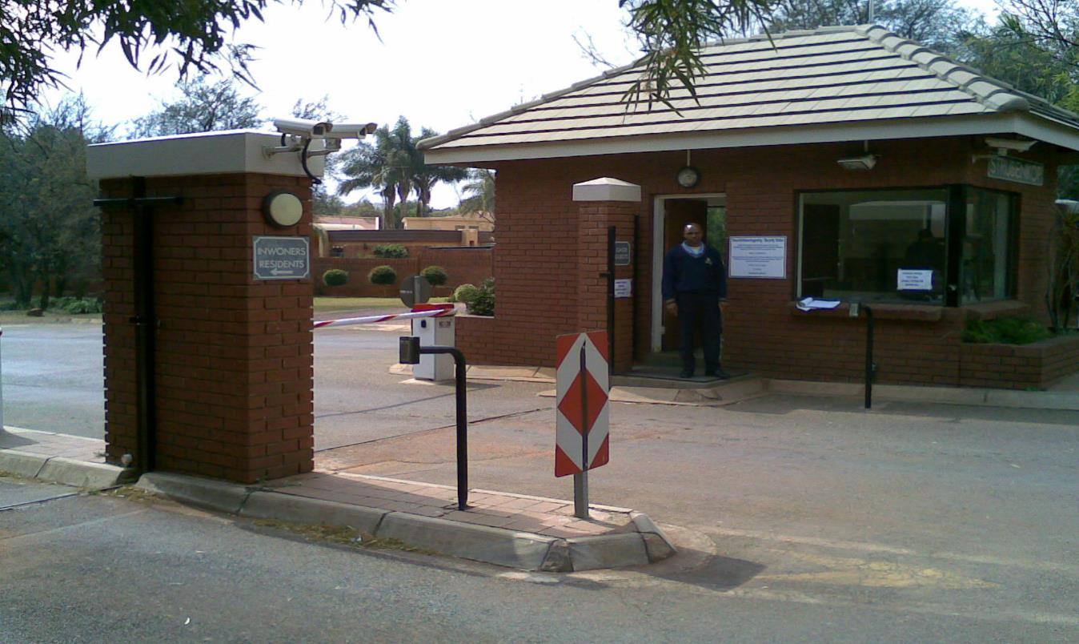
24/7 Guarded Entrances

Slide 28
ENTRANCE GUARDS
Manual override
To handle crisis situations
To aid visitors and answer questions
To ensure that proper procedures are followed
Deterrence value
Proper training and supervision
May not search or prevent entrance

Slide 29
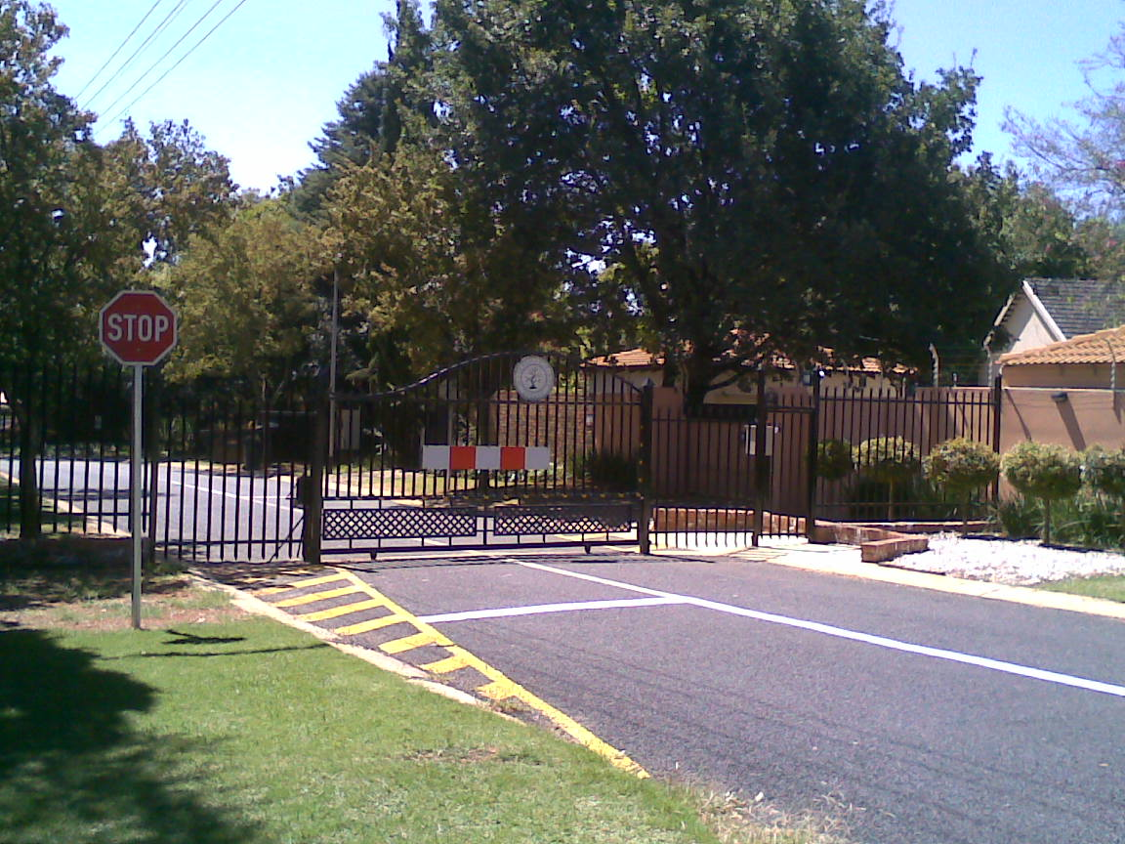
Single Lane Sliding with Remotes or Cell Phone operated

Slide 30
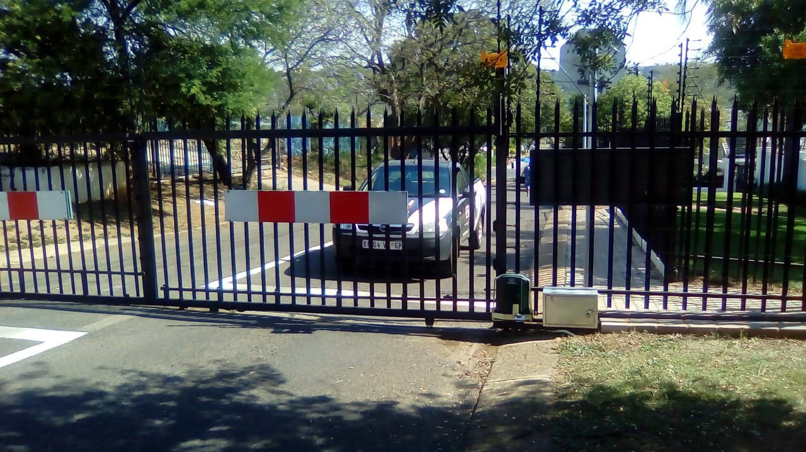

Slide 31
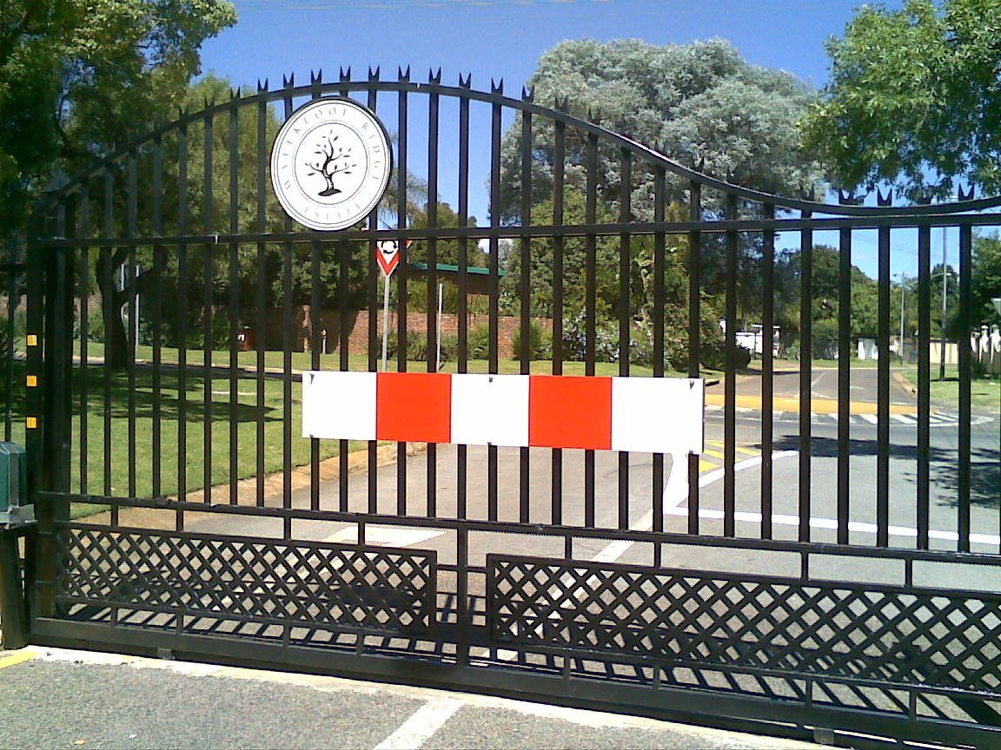
Gate Details with Chevrons

Slide 32
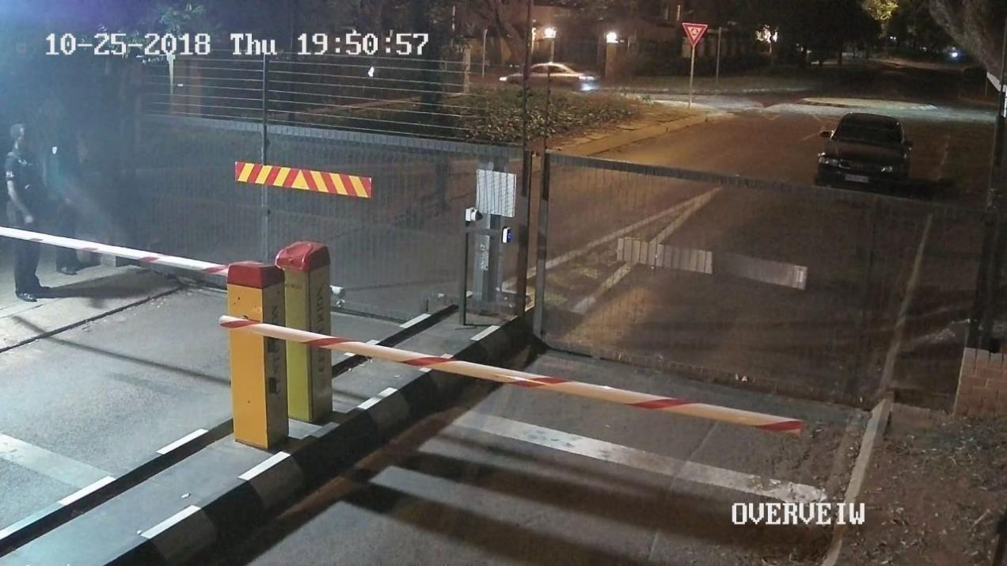
Lockdown with light at night

Slide 33
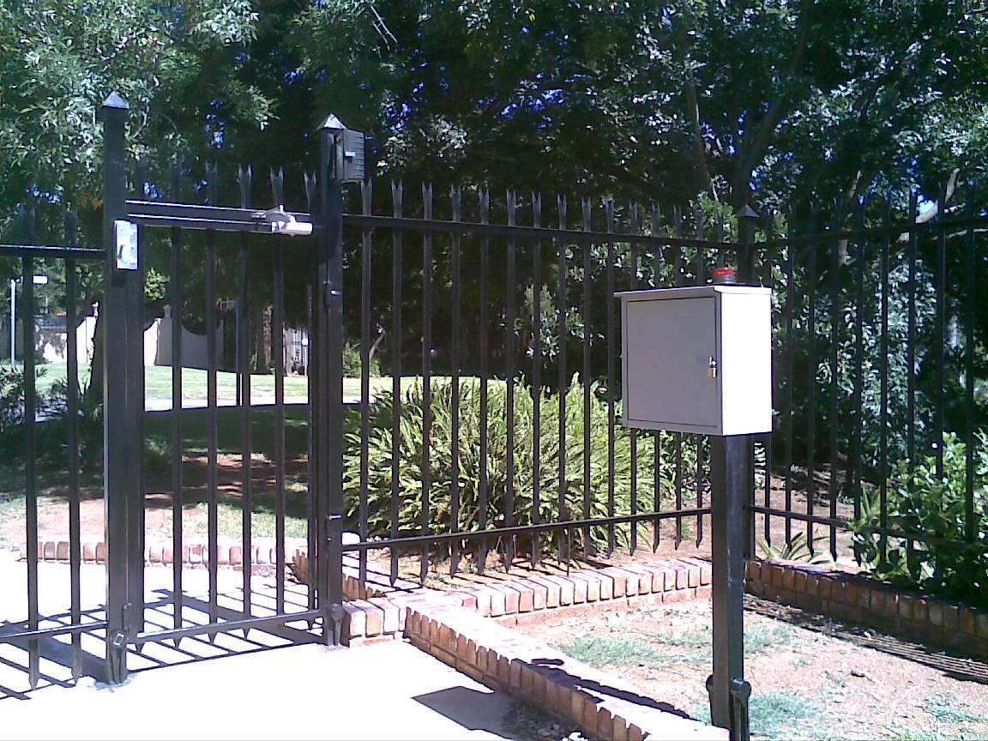
Pedestrian Gates with tags

Slide 34
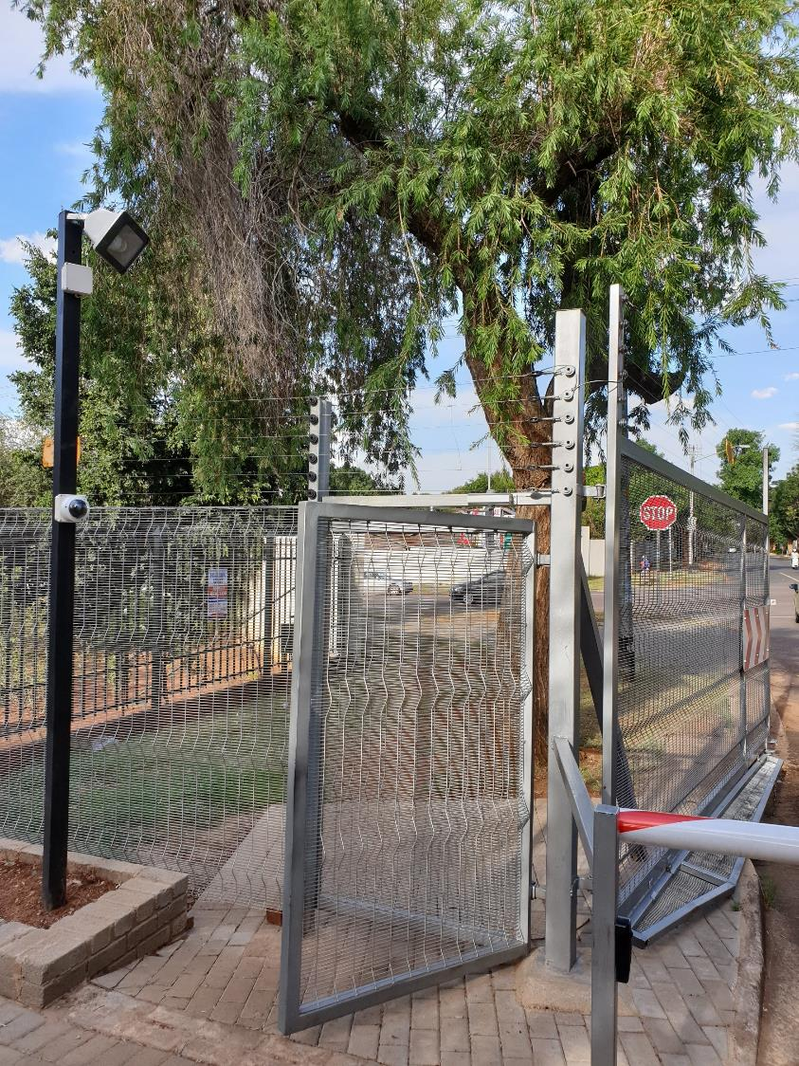

Slide 35
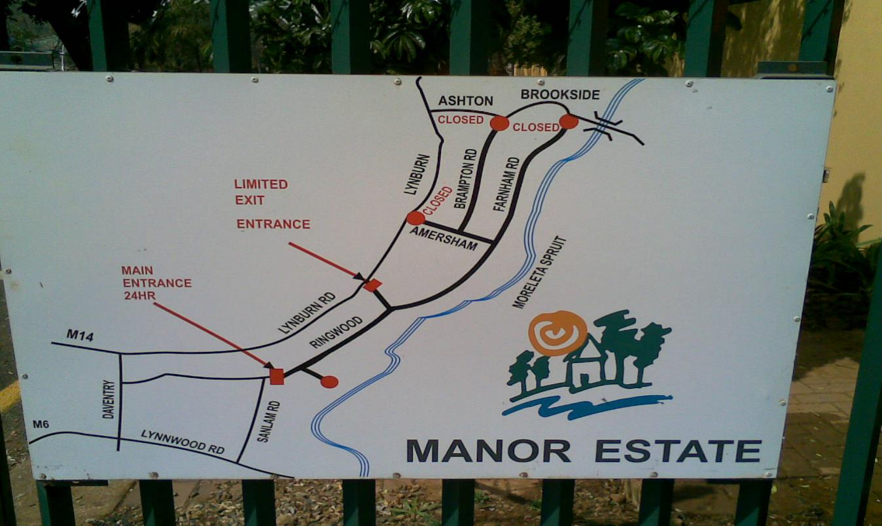
Proper Markings

Slide 36
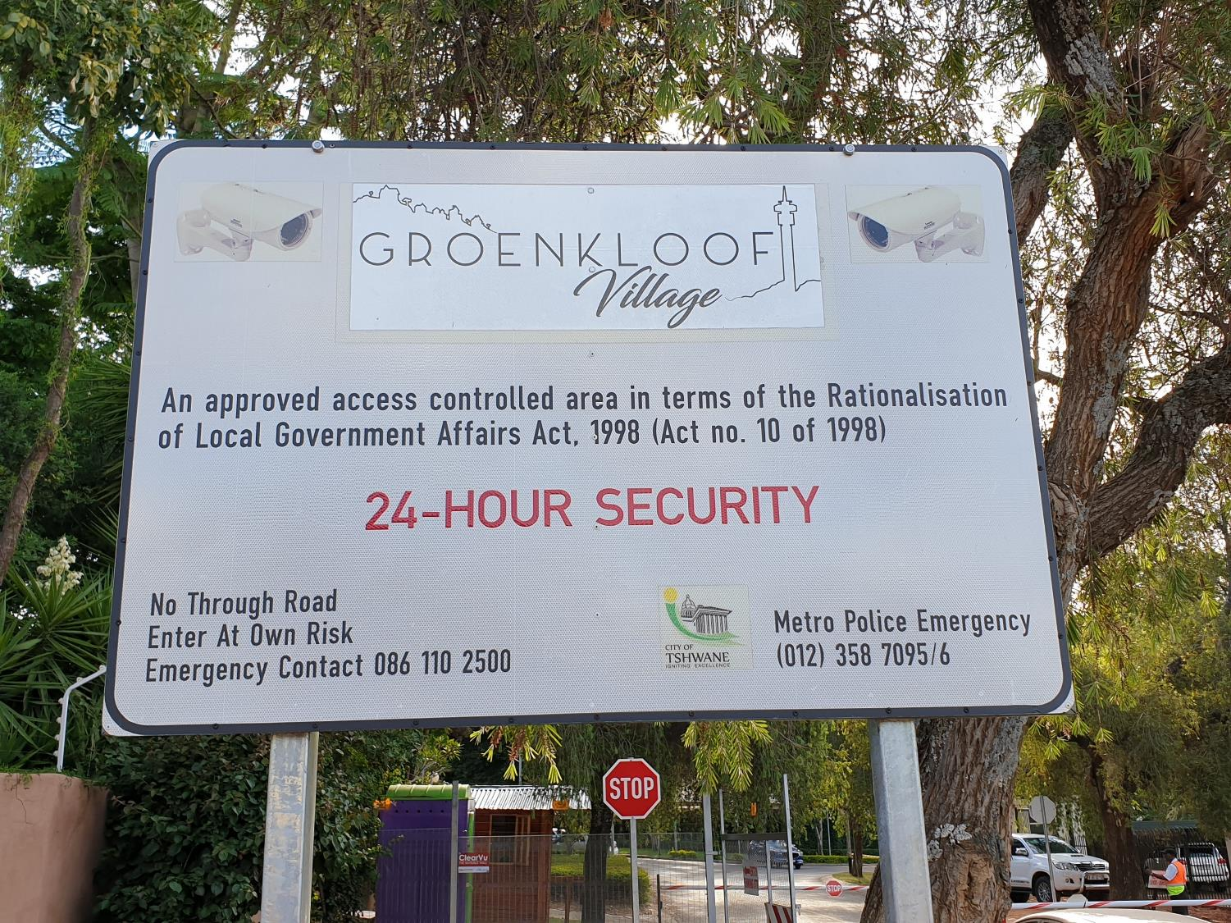

Slide 37
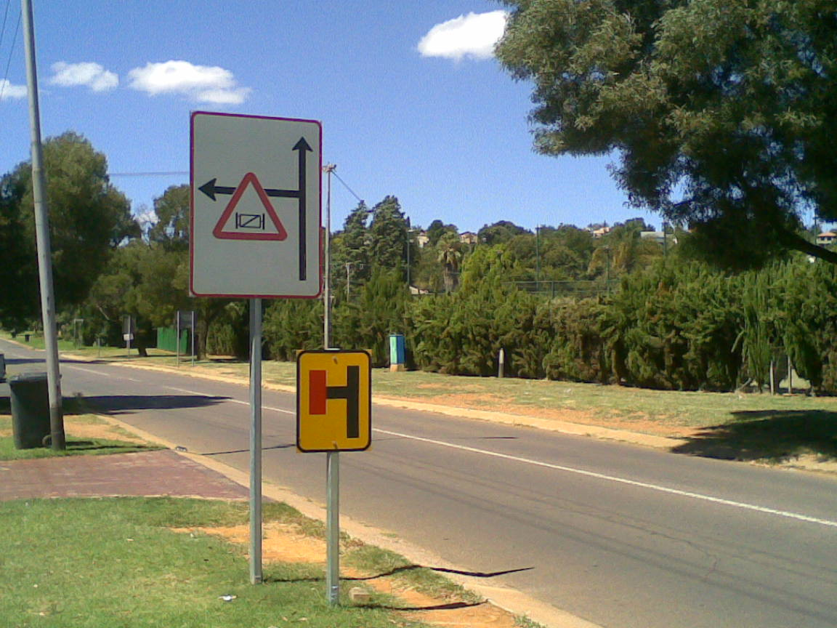
Road Signs

Slide 38
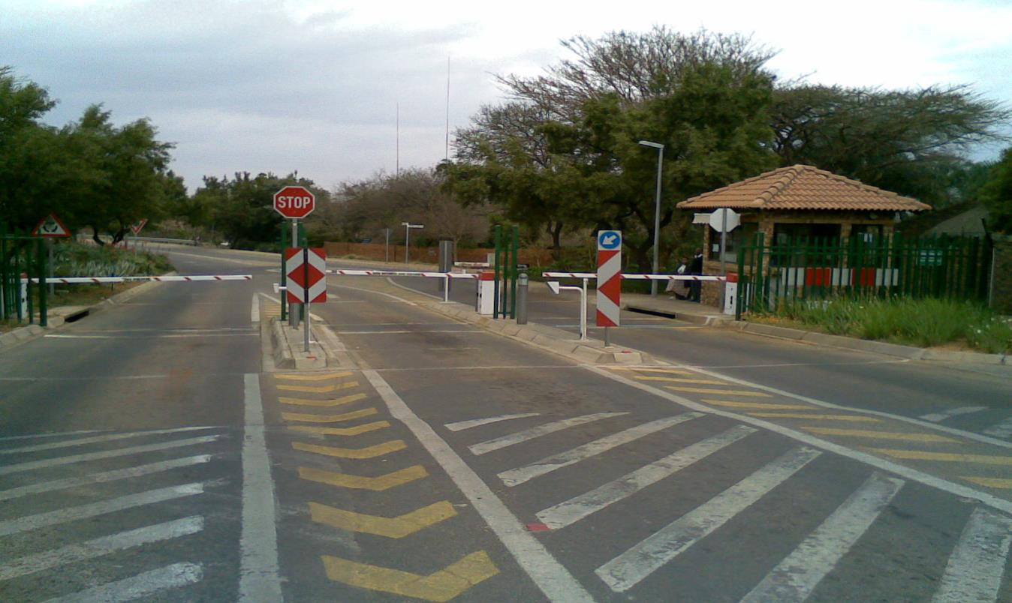
Proper Road Markings & Signage

Slide 39
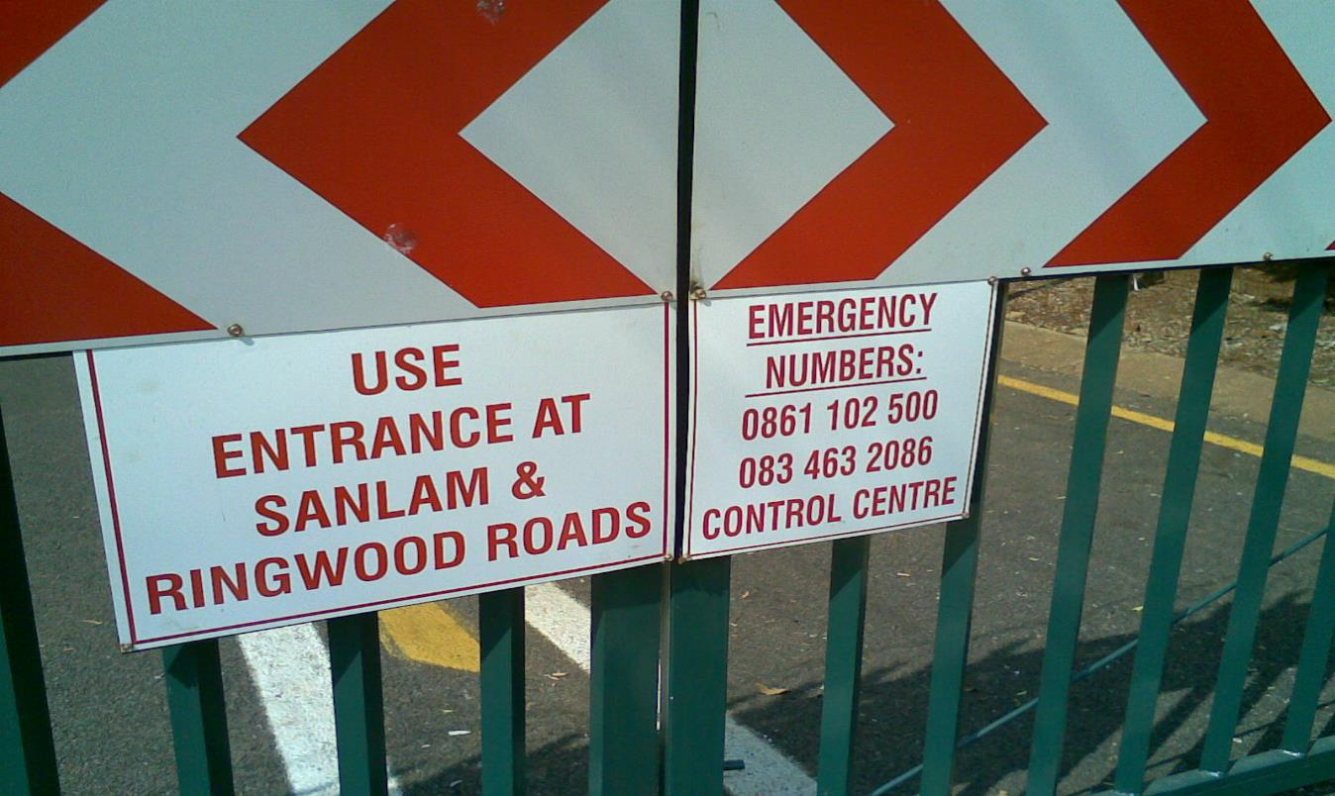
Emergency Numbers

Slide 40
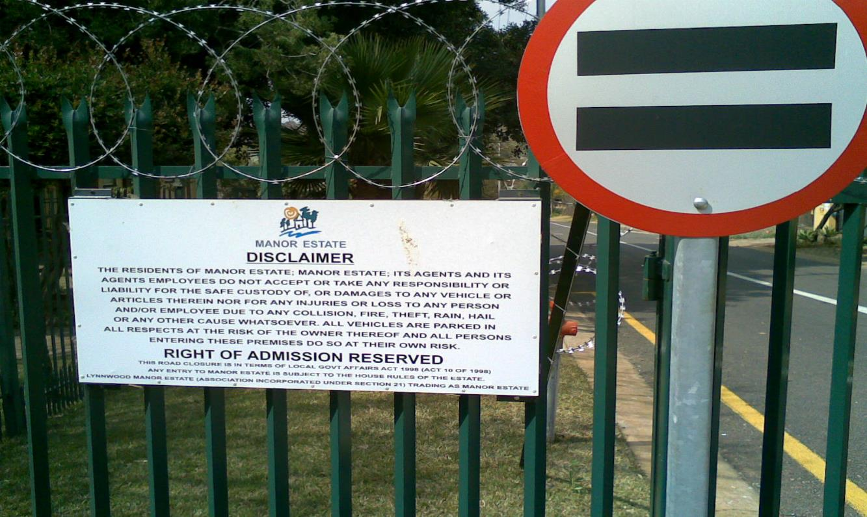
Disclaimers

Slide 41
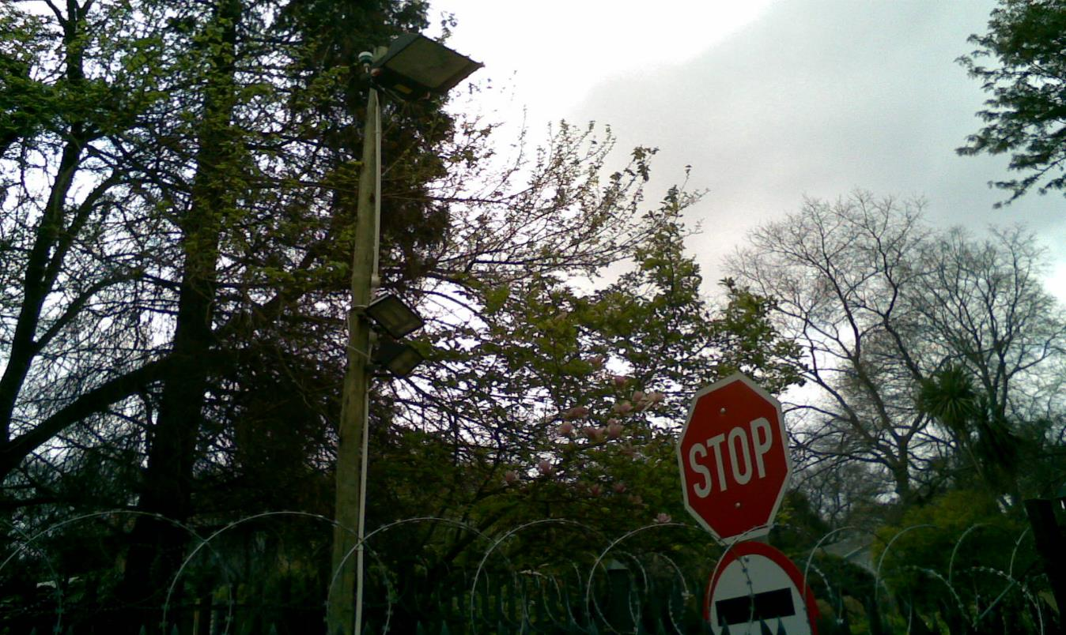
Proper Lighting

Slide 42
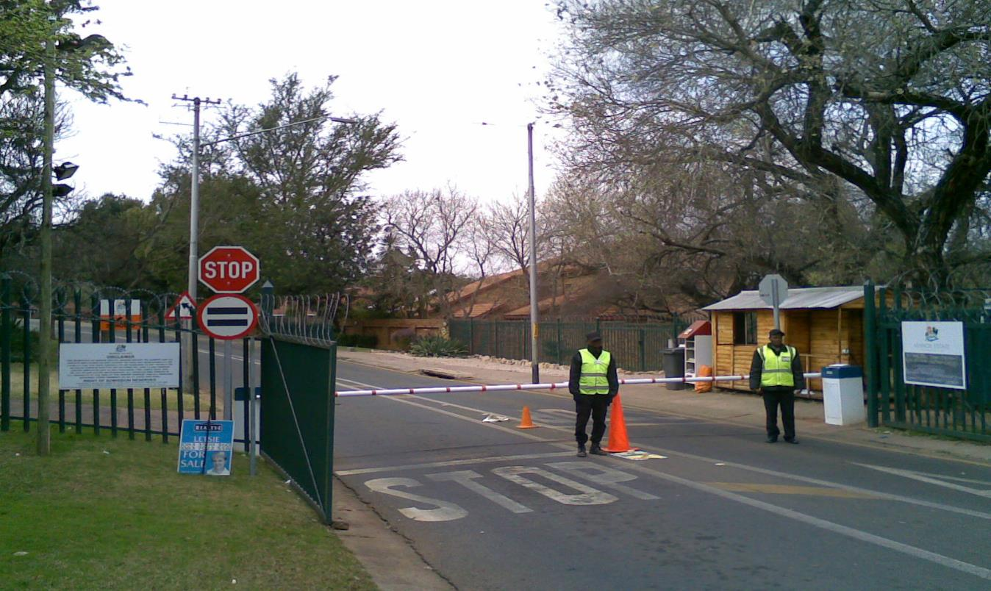
Adequate Guards

Slide 43
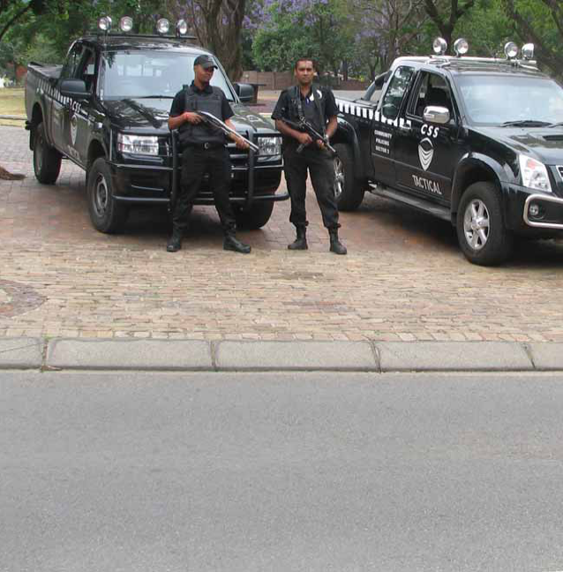
Dedicated Patrol Vehicles

Slide 44
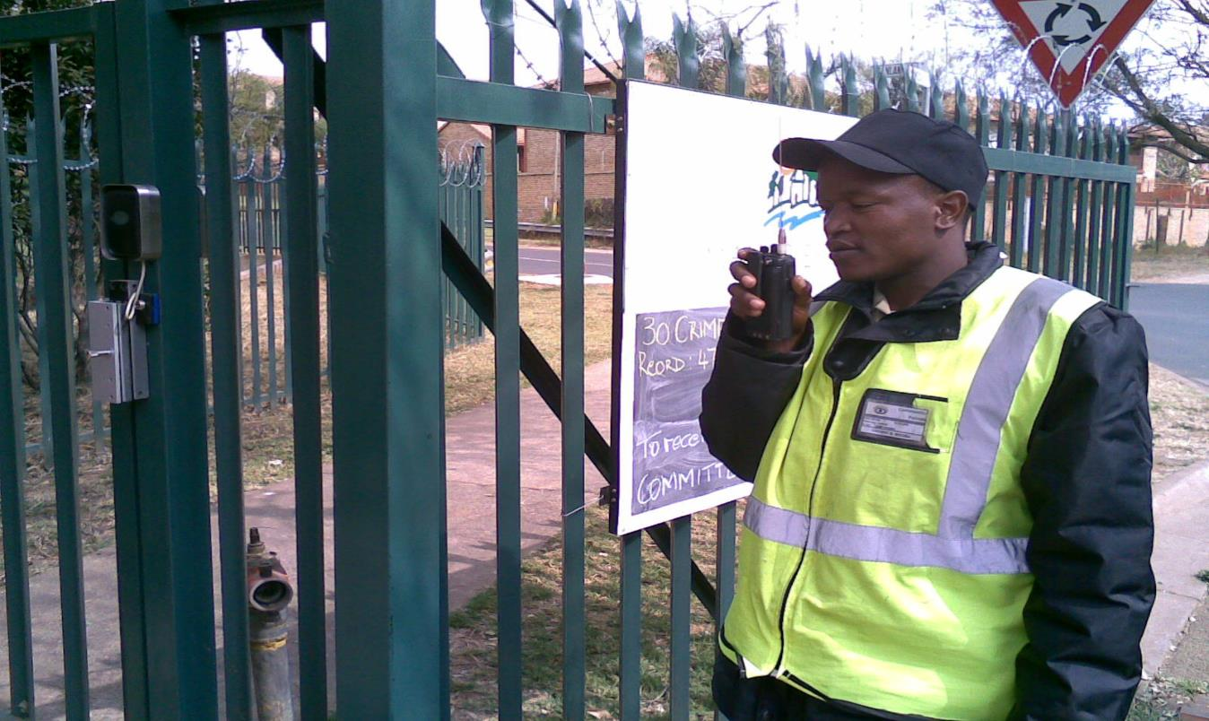
Radio Communication

Slide 45
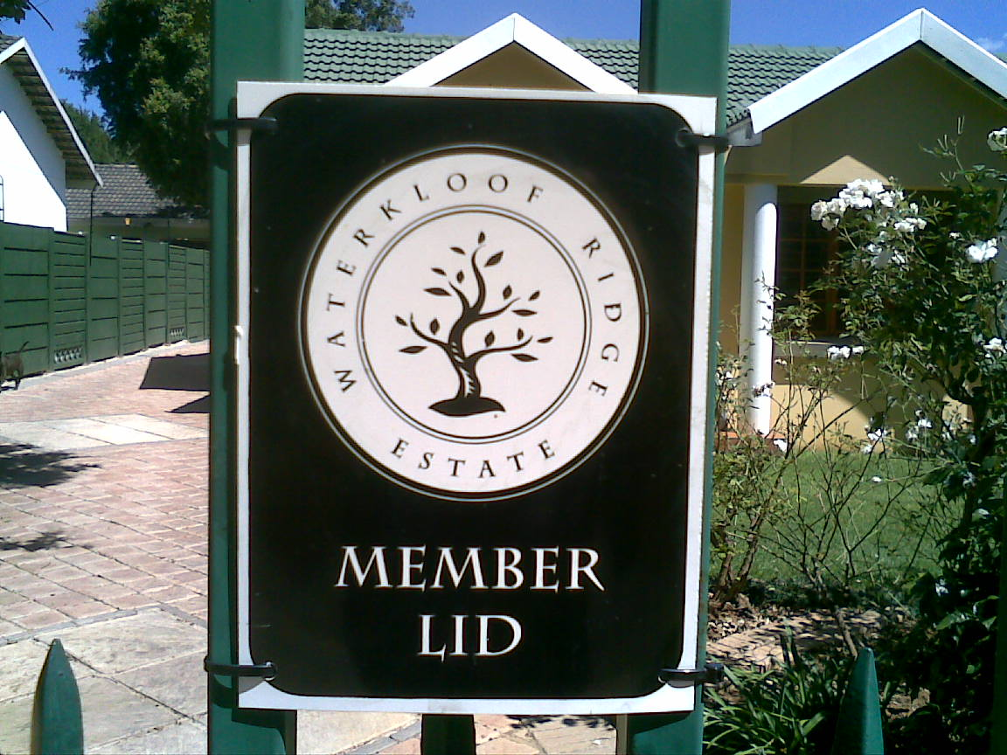
Member Boards

Slide 46
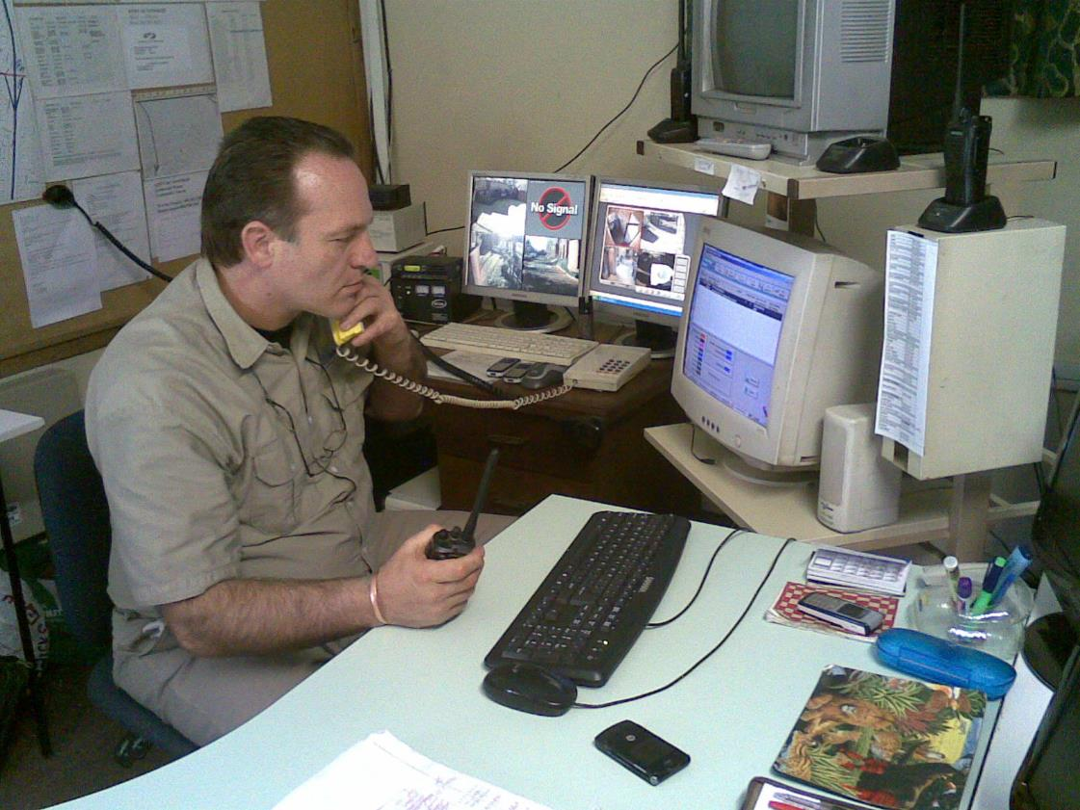
24/7 Control Centre Monitoring

Slide 47
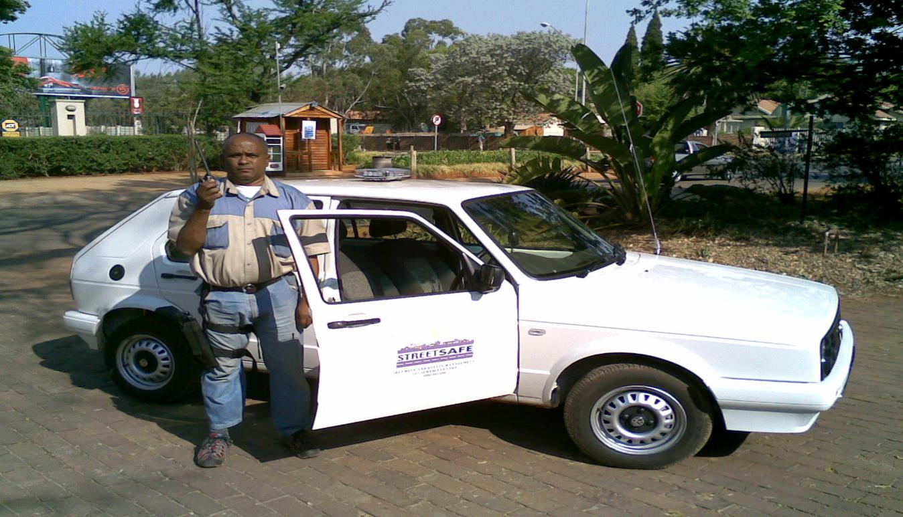
EXTERNAL SUPERVISION

Slide 48
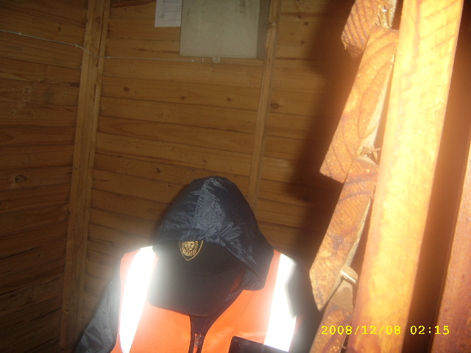

Slide 49
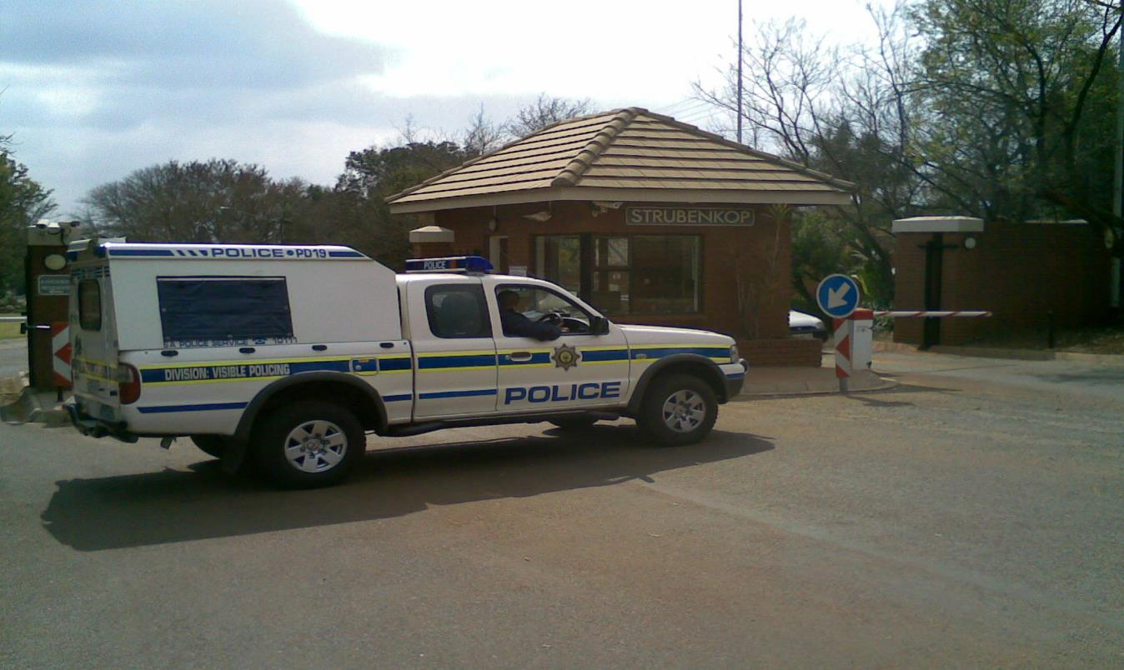
SAPS Support

Slide 50
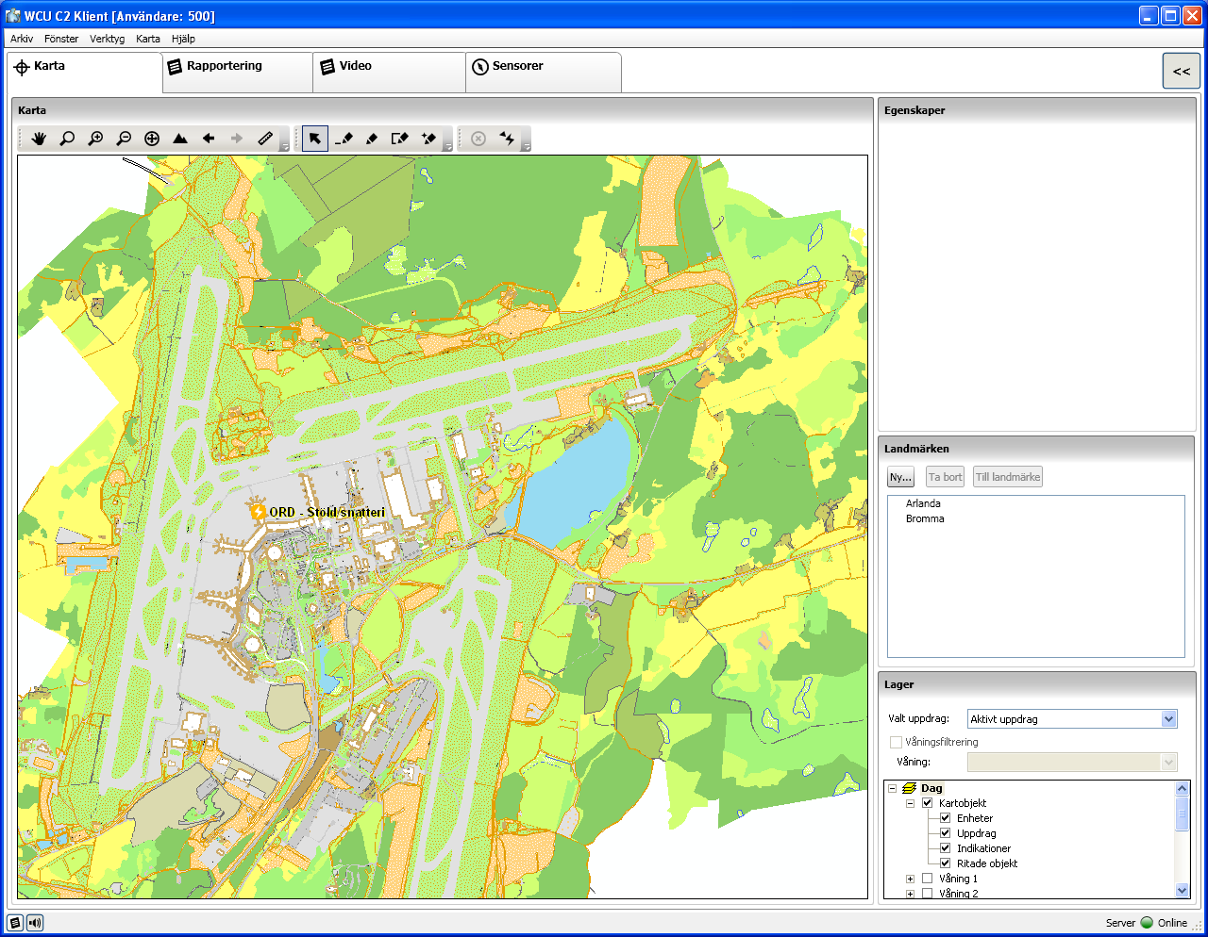
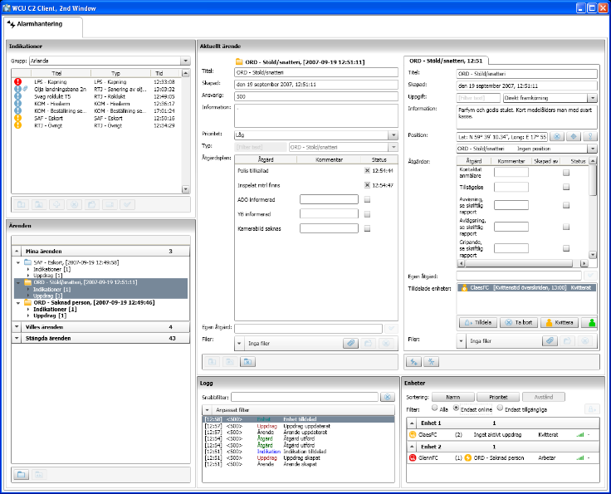
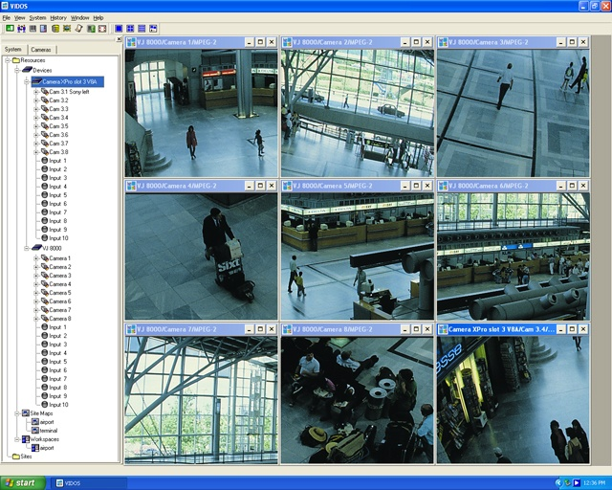
A Common Situational Picture…….
…not only in the Command center…..

Slide 51
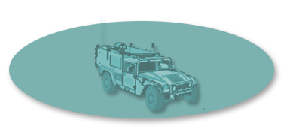
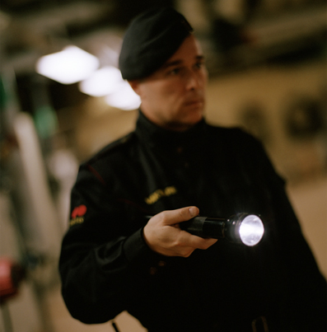
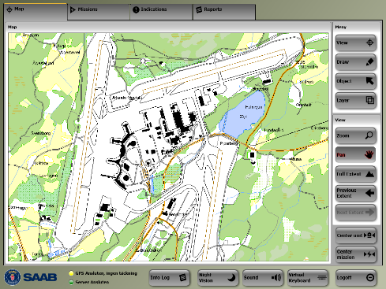
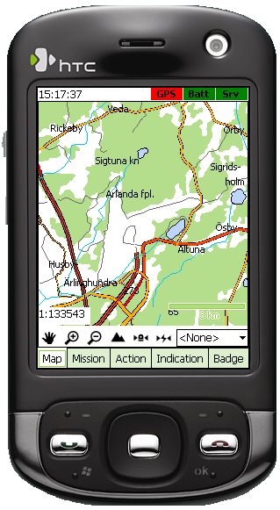
…..but also for the personnel who has to act on the tasks!

Slide 52
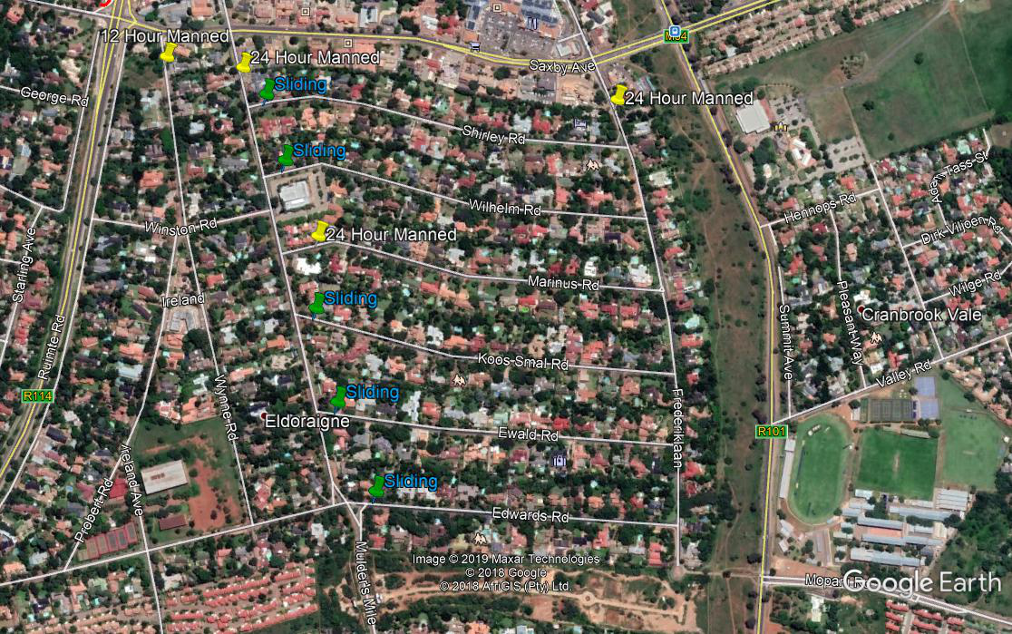

Slide 53
Option 1 Eldoraigne Central East
228 Houses, 70% = 160
2 x 24 Hour manned (Frederik (north) & Marinus (west)
7 x Sliding service gates
1 x Pedestrian entrance Frederik (south)
1150 m palisade fencing along Ruimte Weg
No dedicated vehicle
Dep 1 (application) = R 3065
Dep 2 (construction) = R 26 109
Monthly levy = R 1052

Slide 54
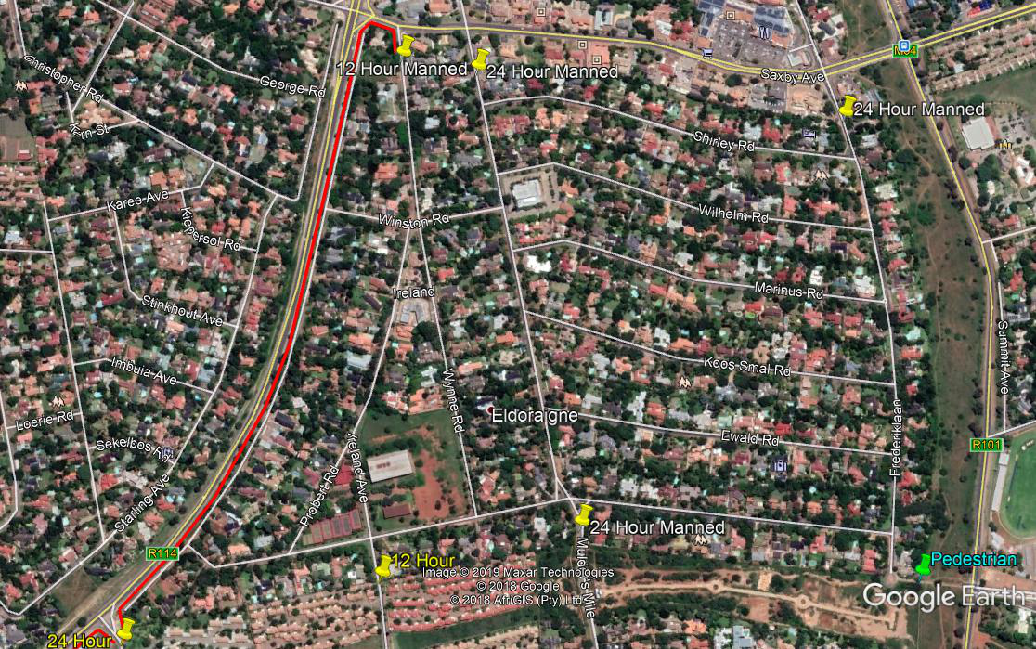

Slide 55
Option 1 Eldoraigne Central (North)
359 Houses, 70% = 251
3 x 24 Hour manned entrances (Frederik (north) & Mulders Mile n&s)
2 x 12 Hour manned entrances (Wynne (north) and Ireland (south)
1 x Pedestrian entrance Frederik (south)
1150 m palisade fencing along Ruimte Weg
No dedicated vehicle
Dep 1 (application) = R 1779
Dep 2 (construction) = R 15 386
Monthly levy = R 924

Slide 56
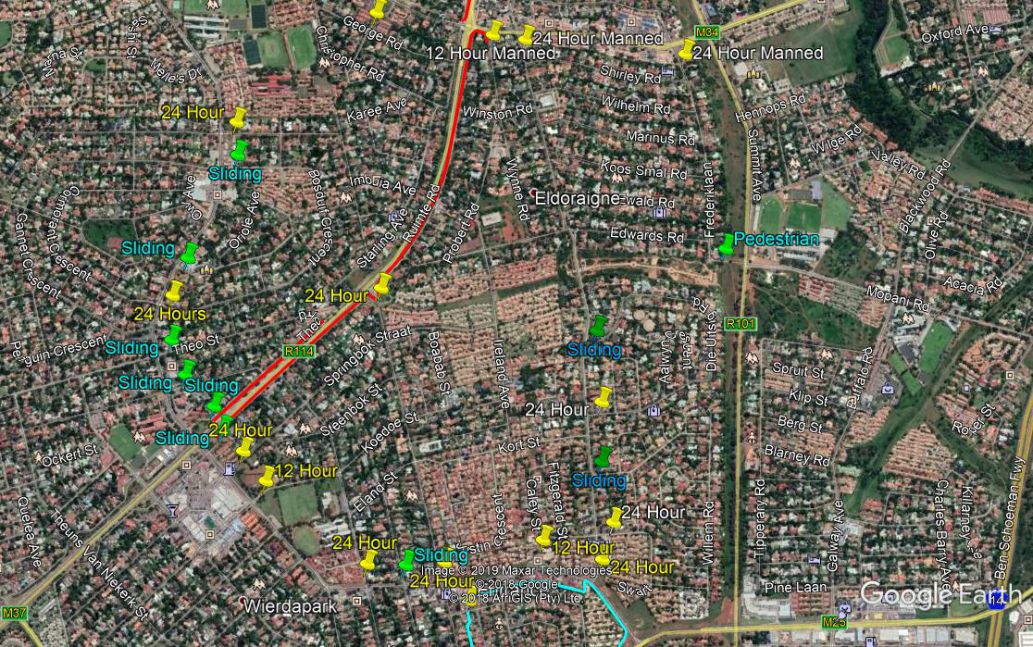

Slide 57
Option 1 Eldoraigne Central (Together)
1029 Houses, 496 Townhouses (124) = 1153 payers, 70% = 807
7 x 24 Hour manned entrances
3 x 12 Hour manned entrances
1 x Pedestrian entrance Frederik (south)
2000 m palisade fencing along Ruimte Weg
Two dedicated vehicles
Dep 1 (application) = R 1243 (R311)
Dep 2 (construction) = R 10 101 (R2 525)
Monthly levy = R 761 (R190)

Slide 58
RESULTS

Slide 59
Benefits of Closure
Safe environment for young & old
Manageable safety environment
Improved living conditions
Easier to sell and rent – 10%+ investment
R10 000 investment = at least R100 000-00 increase/growth on property value!!
Reduced short term insurance premium
Collective bargaining for cheaper armed reaction

Slide 60
Private Property – 10 most in demand suburbs in Pretoria – 11 Aug 2018
Suburb | Median | House | Flat | Complex
Waverly | R1 995 000 | R2 200 000 | R655 000 | R1 750 000
Erasmuskloof | R1 950 000 | R2 500 000 | R695 000 | R1 395 000
Queenswood | R1 350 000 | R1 850 000 | R699 000 | R907 500
Garsfontein | R1 650 000 | R1 895 000 | R1 080 000 | R1 190 000
Lynnwood | R2 897 000 | R3 700 000 | R1 300 000 | R1 950 000
Rietvalleirand | R2 133 553 | R2 531 923 | R958 750 | R1 295 000
Elardus Park | R1 490 000 | R1 835 000 | R850 000 | R1 099 000
Menlo Park | R2 550 000 | R2 850 000 | R1 720 000 | R2 300 000
Moreleta Park | R1 795 000 | R2 380 000 | R750 000 | R1 290 000
Faerie Glen | R1 985 000 | R2 475 000 | R860 000 | R1 390 000

Slide 61
Optional Extra
Full alarm monitoring and armed reaction @ reduced rate per month
Streetsure short term insurance saving of up to 25% on monthly premiums – Phone Sapcor at 012 9988295 for quote

Slide 62
Requirements by Council
67% (70%) Support by owners
Traffic Impact Study
Formal Application compiled
Application Fee paid
All departments to approve
SLDT give principal approval
40 days advertising for objections
58 requirements – way leave approval
2 years re-application

Slide 63
Projected Time Frame
P1: Get 70% support and money for application – Jan - May 2020
P2: Traffic Impact study + Application drawn up – June, July 2020
P3: Permission by Council – March 2021
P4: Construction – July, Aug, Sep 2021
P5: Operational – 1 Oct 2021

Slide 64
WHO?
HOA (Sec 21 Company)
  Contracting
  Monitoring and Management
  Own Bank Account
  Annual Meeting, Audit, Budget
Streetsafe (Pty Ltd)
  Planning, Traffic Impact Study, Application for Closure
  Project management for Implementation
Paxton Cerva (Pty Ltd)
  Administration
  Levy Collection and Bookkeeping

Slide 65
CONTACT US
Paxton Cerva
  property@pcps.co.za
  012 365 3320
Streetsafe
  jan@streetsafe.co.za
  082 784 0807

Slide 66
WHY STREETSAFE?
Proven track record
24/7 control room
Proven to provide security
One stop solution – admin, security, technology
Management company, not security coy

Slide 67
WHAT NEXT?
Finalize Plan and Street Representatives
Contract Streetsafe & Management Company
Prepare Welcome Packs and Public Meeting
Sign up 70% members
Traffic impact study
Application to Council

Slide 68
Eldoraigne -Street Closure Meeting
11 December 2019
Welcome – Adriaan Goosen
Jan Malan - Streetsafe-Security Solution
Do you want us to test support for proposal in Eldoraigne?
Questions
Nominations and Election of Committee
Administration
Closure – Adriaan Goosen

