Slide 1
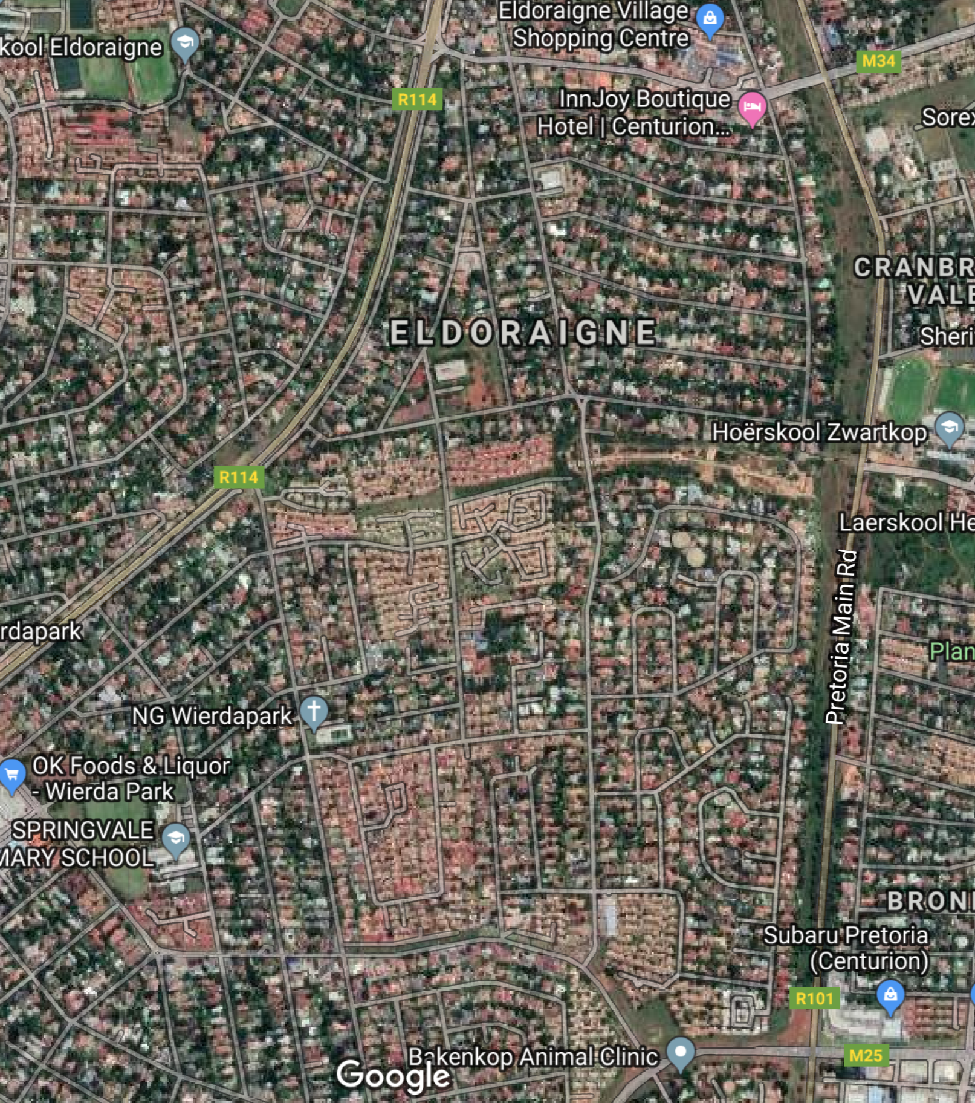
INITIATIVE TO CREATE
“RESTRICTION OF ACCESS”
ELDORAIGNE
11 December
2019

Slide 2
AGENDA
“Unless the Lord builds the house, the builders labor in vain. Unless the Lord watches over the city, the guards stand watch in vain.”
Psa 127
Welcome
Attendance Register / Streets, Complexes
Background and Purpose for Initiative
Municipal Application
Proposed Boomed Area
Streetsafe – Jan Malan
Proposed Working Committee/s (Voting)
Next Meeting (Date and Agenda)

Slide 3
ATTENDANCE
COMPLEX | STREET
Eldo 3 Manor | Aalwyn Cres | Ewald Road | Kort Street | Soetdoringdraai Street
Frizzante | Anthill Cres | Fitzgelrald Street | Little Lane | Springbok Street
Henri Place | Baobab Street | Frederik Avenue | Lyell's Lane | Suni Nook
Ilanda Place | Blue Gum Bend | Garnet Street | Marinus Road | Swart Street
Ireland Gardens | Brendon Pl | Guineafowl Walk | Mulder's Mile | Tanyas Terrace
Ireland Heights | Caley Street | Henri Road | Plover's Path | Weavind Ave
Ireland Hills | Colleen Nook | Ingrid's Isle | Quiet Cl | Wilhelm Road
Ireland Park | Die Koppie Street | Ireland Avenue | Rene's Road | Willem Road
Ireland Place | Die Uitsig Road | Justin Cres | Roan Nook | Will's Way
Justin Villas | Drienie Street | Koedoe Street | Shamrock Nook | Winston Road
Mardine Park | Edwards Road | Koos Smal Road | Shirley Road | Wynne Road
Maritane
Swallow's Nest
Uitsig Park
STREETS = 47
COMPLEXES = 24
BUSINESSES = 84
CHURCES = 4

Slide 4
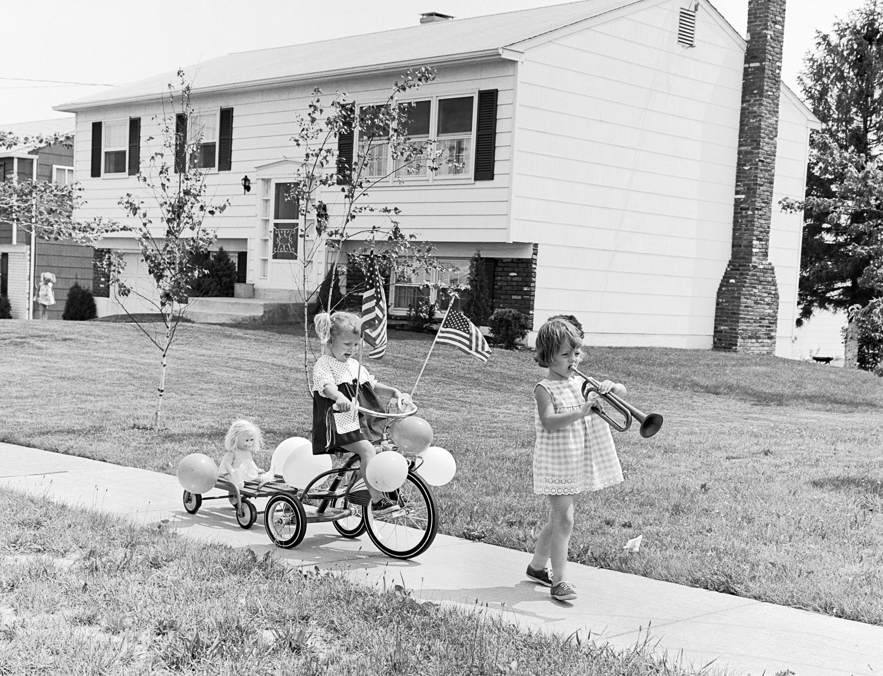
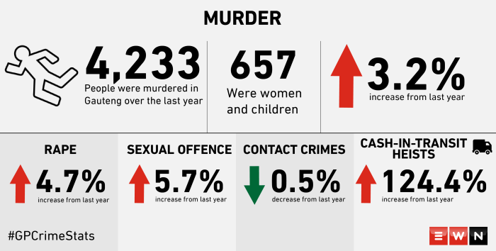
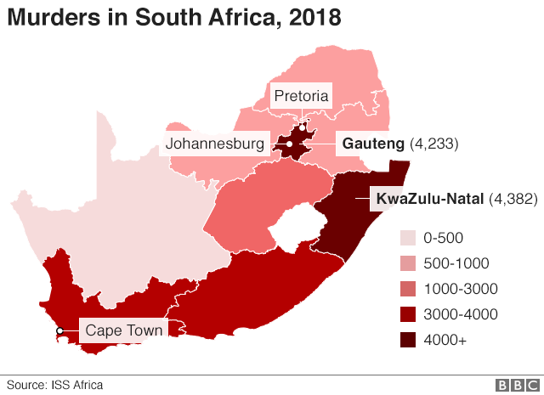

BACKROUND
CRIME
PROPERTY VALUE
SAFE COMMUNITY

Slide 5
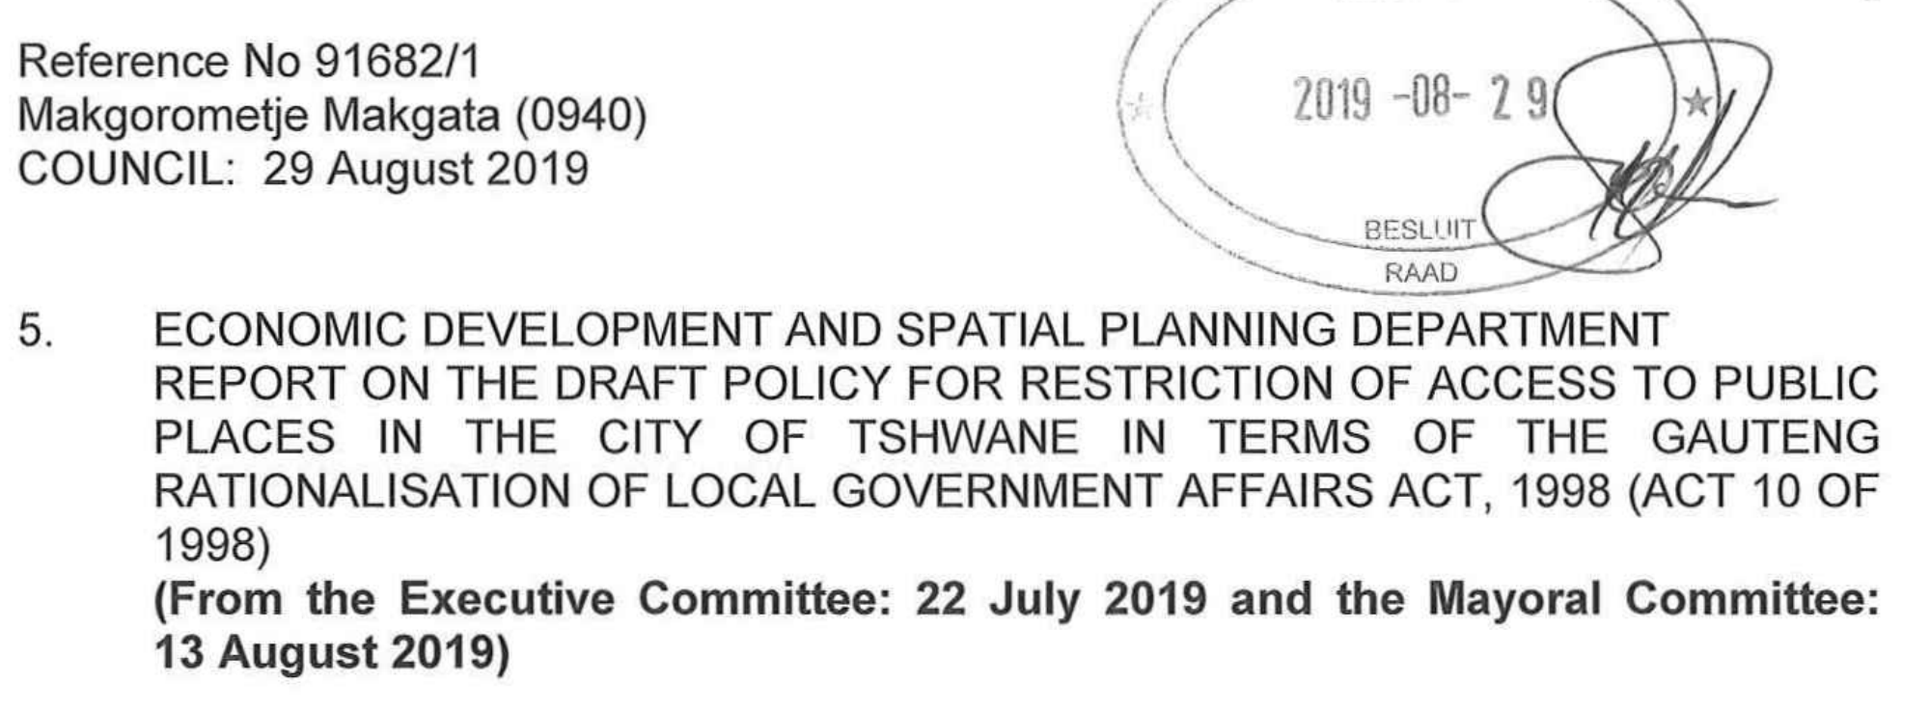
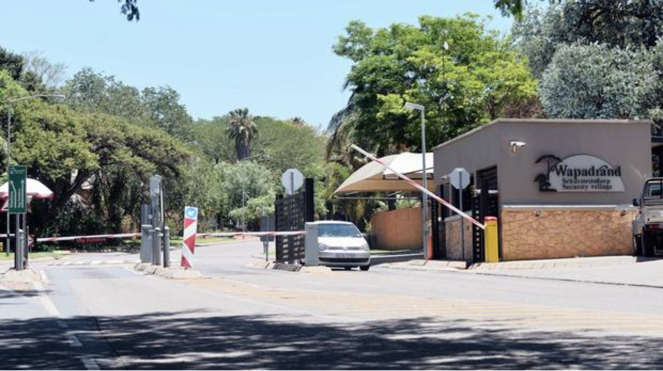
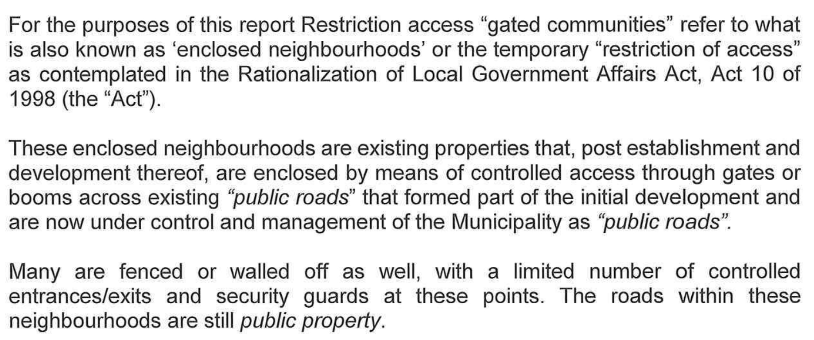
MUNICIPAL
PROCESS
City of Tshwane
Draft Policy for Restriction of Access to Public Places
Definition / Description of “Restriction Access”

Slide 6
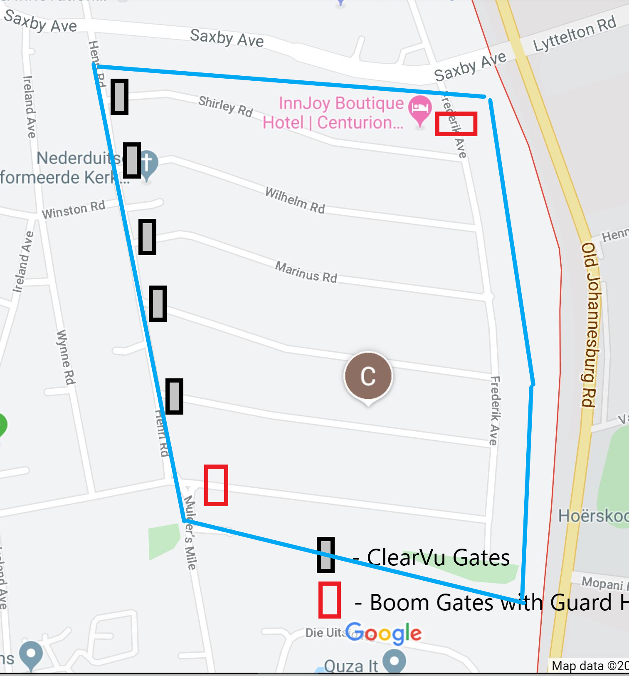
PROPOSED AREA 1
5 X Lockable Gates
1 x Gate at end of Frederik for School Children
2 x Boom Gates

Slide 7

Questionnaire
Getting input from community
Name & Surname, Contact Details?
Do you support the initiative?
Are you willing to contribute to initial CAPEX?
Are you willing to commit to monthly contribution for 24/7 security guards at 2 x boom gates?

Slide 8
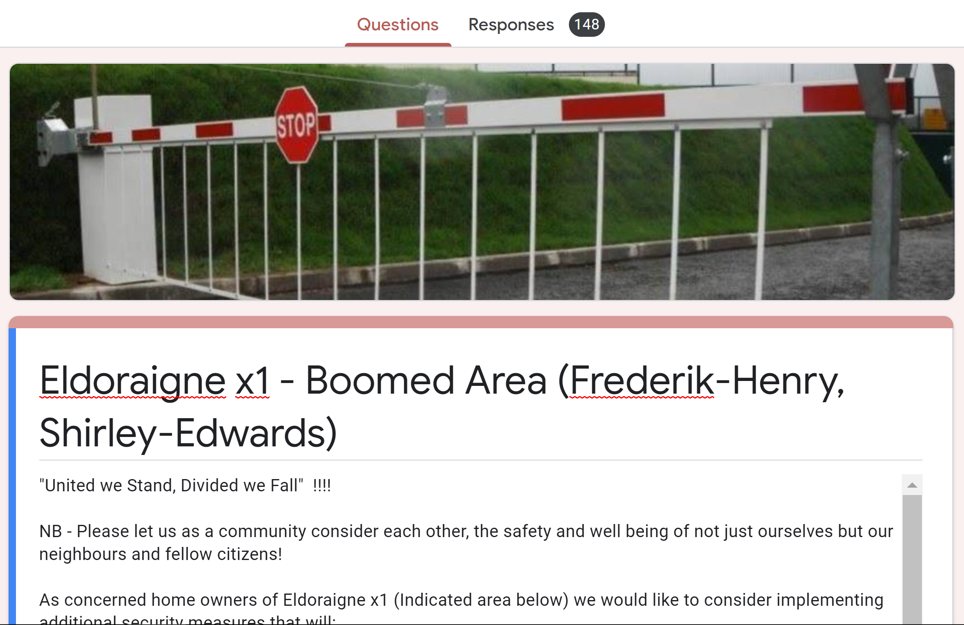
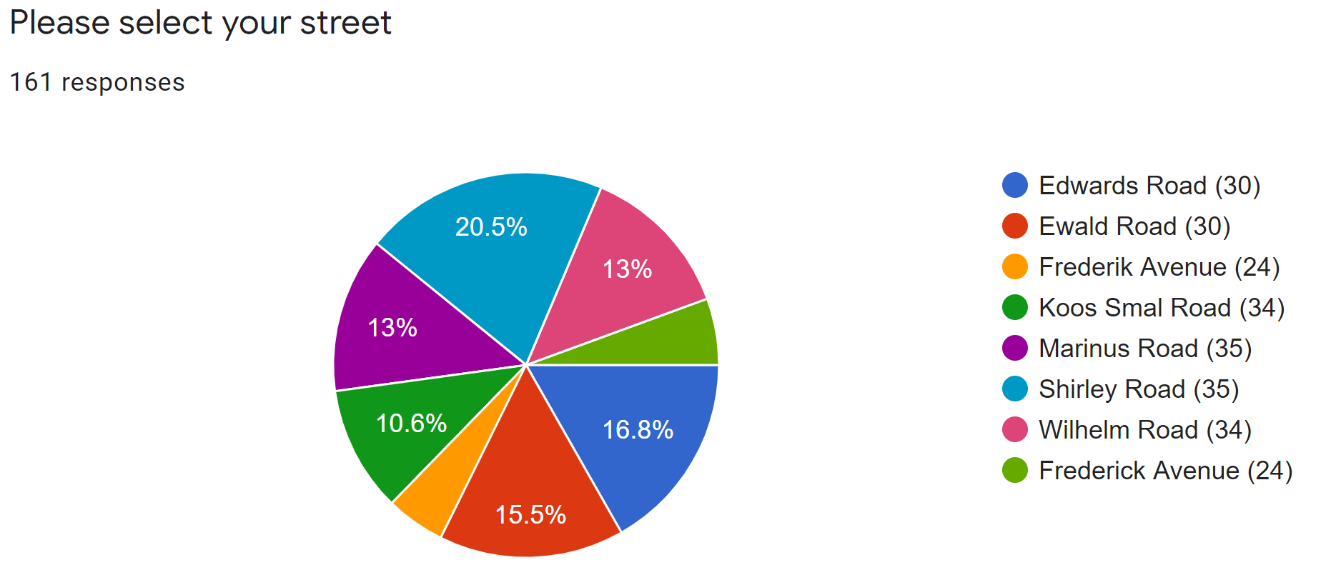
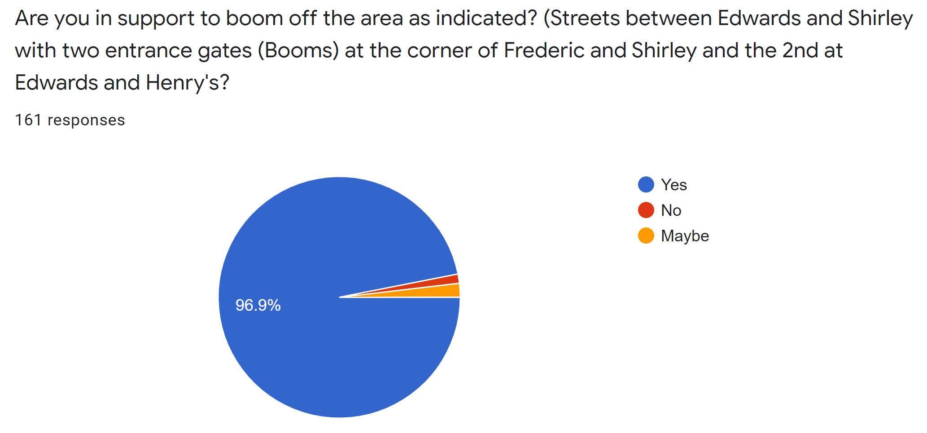
Questionnaire
96,9%
2%

Slide 9
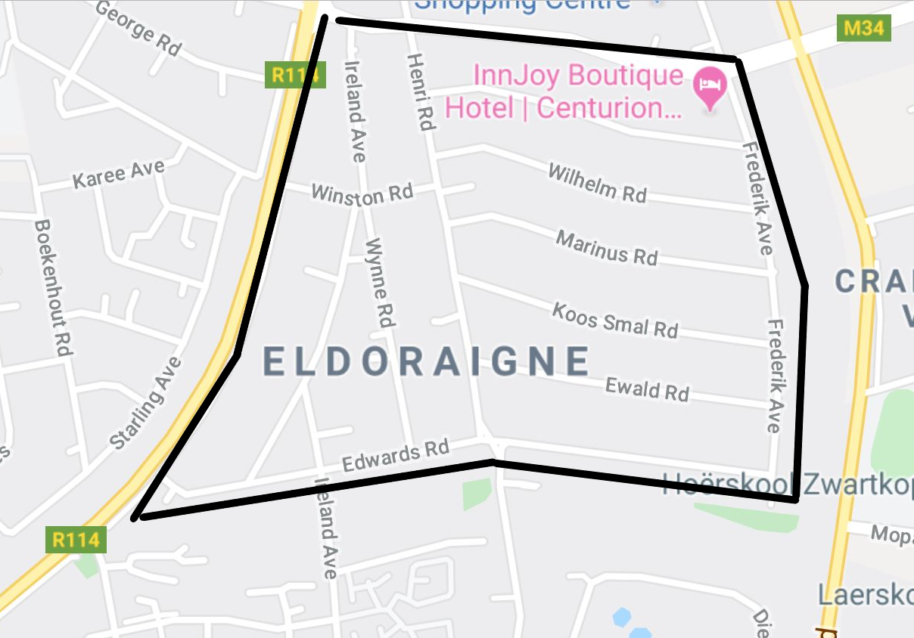
PROPOSED AREA 2
Saxby Road
  Frederik Ave
  Henri Rd
  Ireland Ave
Ruimte Road (R114)
Edwards Road

Slide 10
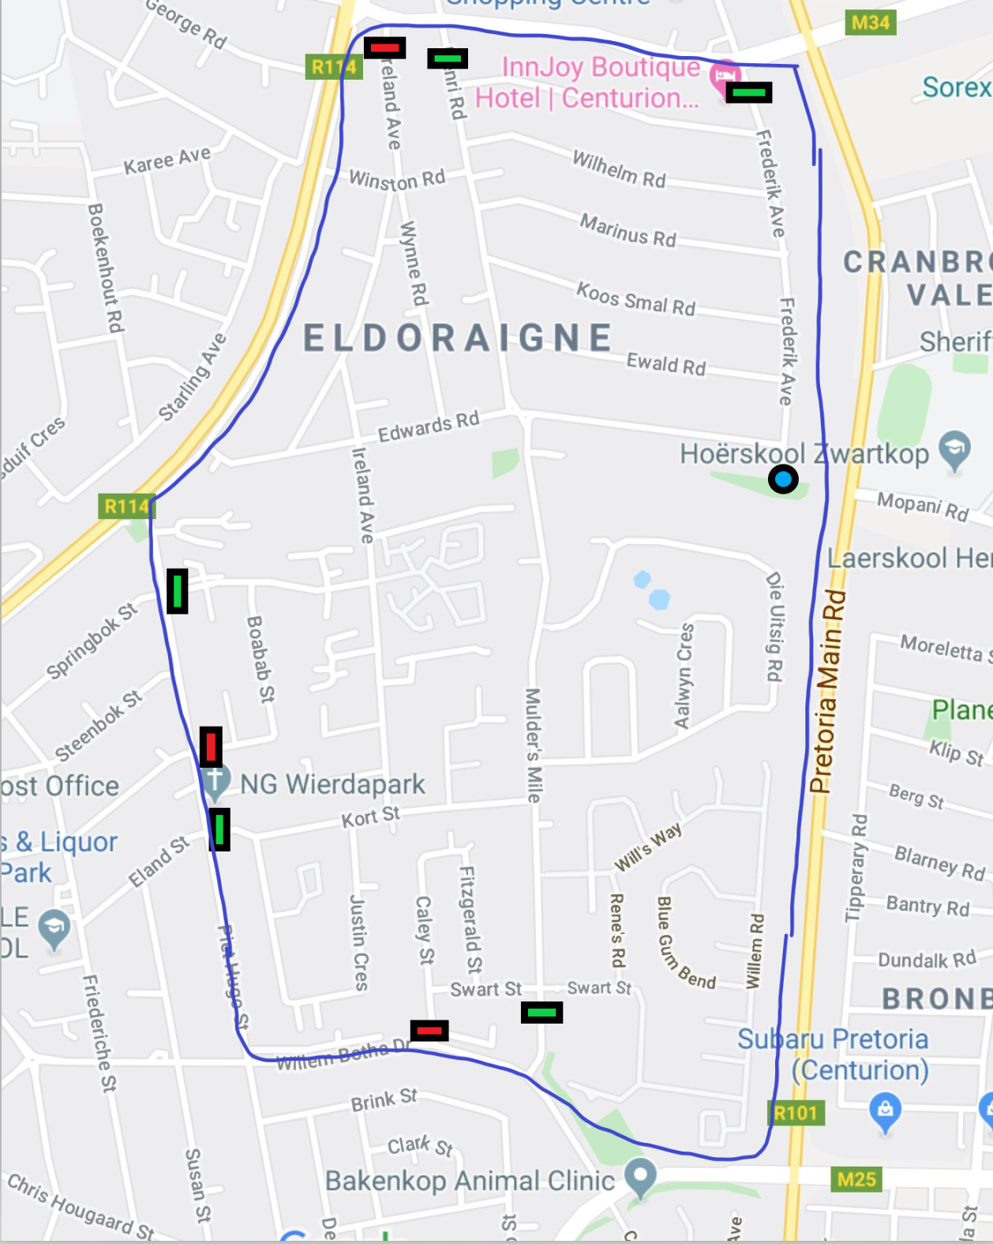
PROPOSED AREA 3
Saxby Road
  Frederik Ave
  Henri Rd
  Ireland Ave
Ruimte Road (R114)
Piet Hugo Street
  Springbok Str
  Boabab St
  Kort St
Willem Botha Drive
  Caley St
  Mulders’s Mile
Old Johannesburg (R101)

Slide 11
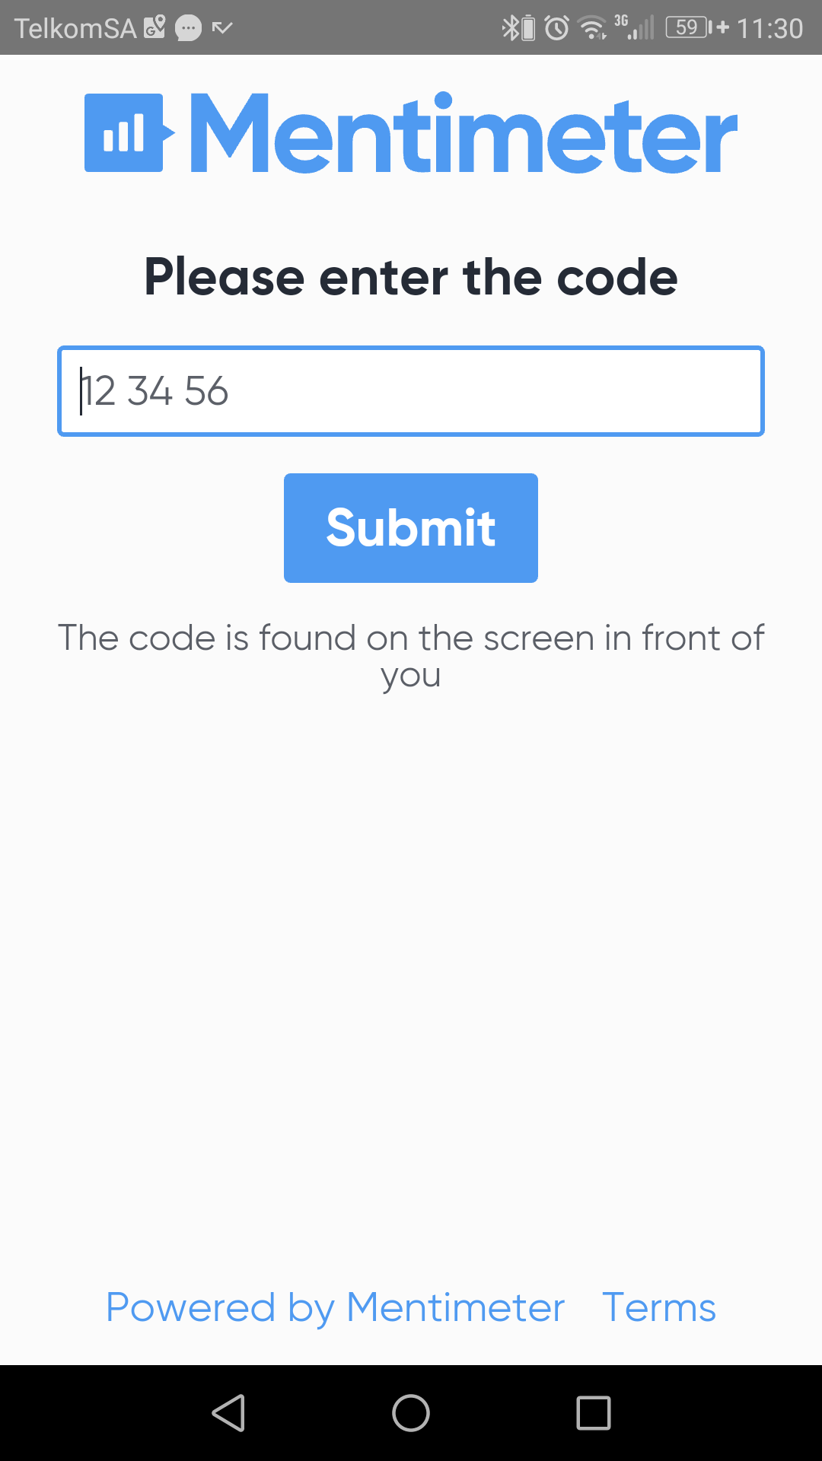
VOTING
B
Preferred Area to “Close / Boom?
Chairperson
Vice Chairperson
Financial Officer
Secretary / Administrator
Communication Officer
Security Manager
Construction Manager
CH
VP
FO
AD
CM
SM
CM

Slide 12
PROPOSED NEXT STEPS
Eldo Prime Committee to meet in January to evaluate and divine strategy
Representatives:
  Confirm / Obtain representatives for all Streets (Captains)
  Confirm / Obtain contact details for Complex Chairpersons
  Confirm / Obtain contact details for all Business
Representatives (Streets and Complexes) to confirm / obtain contact details for all residents
Establish Communication Platforms (Website, WhatsApp, Facebook, Email, etc)
Tshwane Municipal Process
  “Official Electronic and Hardcopy Form” to vote for support of initiative
  Public Participation Meetings
  Traffic Impact Assessment
  Etc

Slide 13
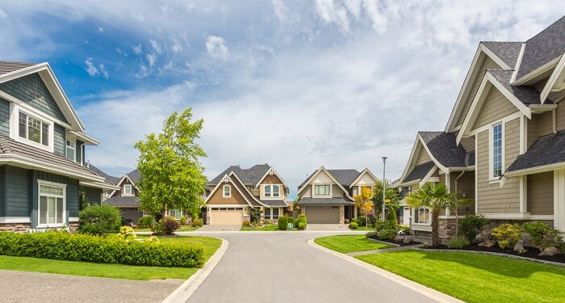
QUESTIONS
Adriaan
Goosen
Phone
081 308 1725
Email
Eldoraigne.adm@gmail.com

