Slide 1
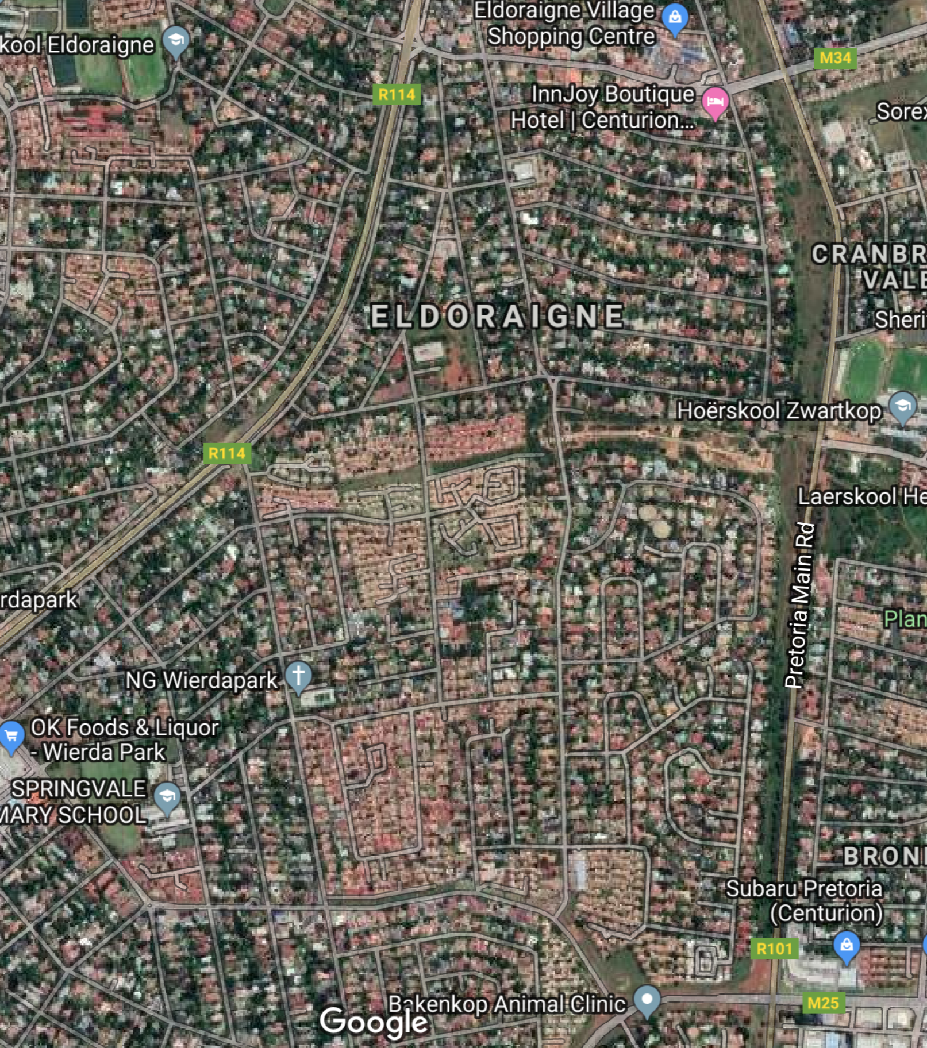
INITIATIVE TO CREATE
“RESTRICTION OF ACCESS”
ELDORAIGNE
27 November
2019

Slide 2
AGENDA
“Unless the Lord builds the house, the builders labor in vain. Unless the Lord watches over the city, the guards stand watch in vain.”
Psa 127
Welcome
Attendance Register / Streets, Complexes
Background and Purpose for Initiative
Municipal Application
Proposed Boomed Area
Proposed Strategy / Action Plan
Parallel process (Temp closure & Municipal Application)
Streetsafe – Jan Malan
Proposed Working Committee/s (Voting)
Next Meeting (Date and Agenda)

Slide 3
ATTENDANCE
COMPLEX | STREET
Eldo 3 Manor | Aalwyn Cres | Ewald Road | Kort Street | Soetdoringdraai Street
Ireland Gardens | Anthill Cres | Fitzgelrald Street | Little Lane | Springbok Street
Ireland Heights | Baobab Street | Frederik Avenue | Lyell's Lane | Suni Nook
Ireland Hills | Blue Gum Bend | Garnet Street | Marinus Road | Swart Street
Ireland Park | Brendon Pl | Guineafowl Walk | Mulder's Mile | Tanyas Terrace
Ireland Place | Caley Street | Henri Road | Plover's Path | Weavind Ave
Mardine Park | Colleen Nook | Ingrid's Isle | Quiet Cl | Wilhelm Road
Uitsig Park | Die Koppie Street | Ireland Avenue | Rene's Road | Willem Road
 | Die Uitsig Road | Justin Cres | Roan Nook | Will's Way
 | Drienie Street | Koedoe Street | Shamrock Nook | Winston Road
 | Edwards Road | Koos Smal Road | Shirley Road | Wynne Road
STREETS = 44
COMPLEXES = 8

Slide 4
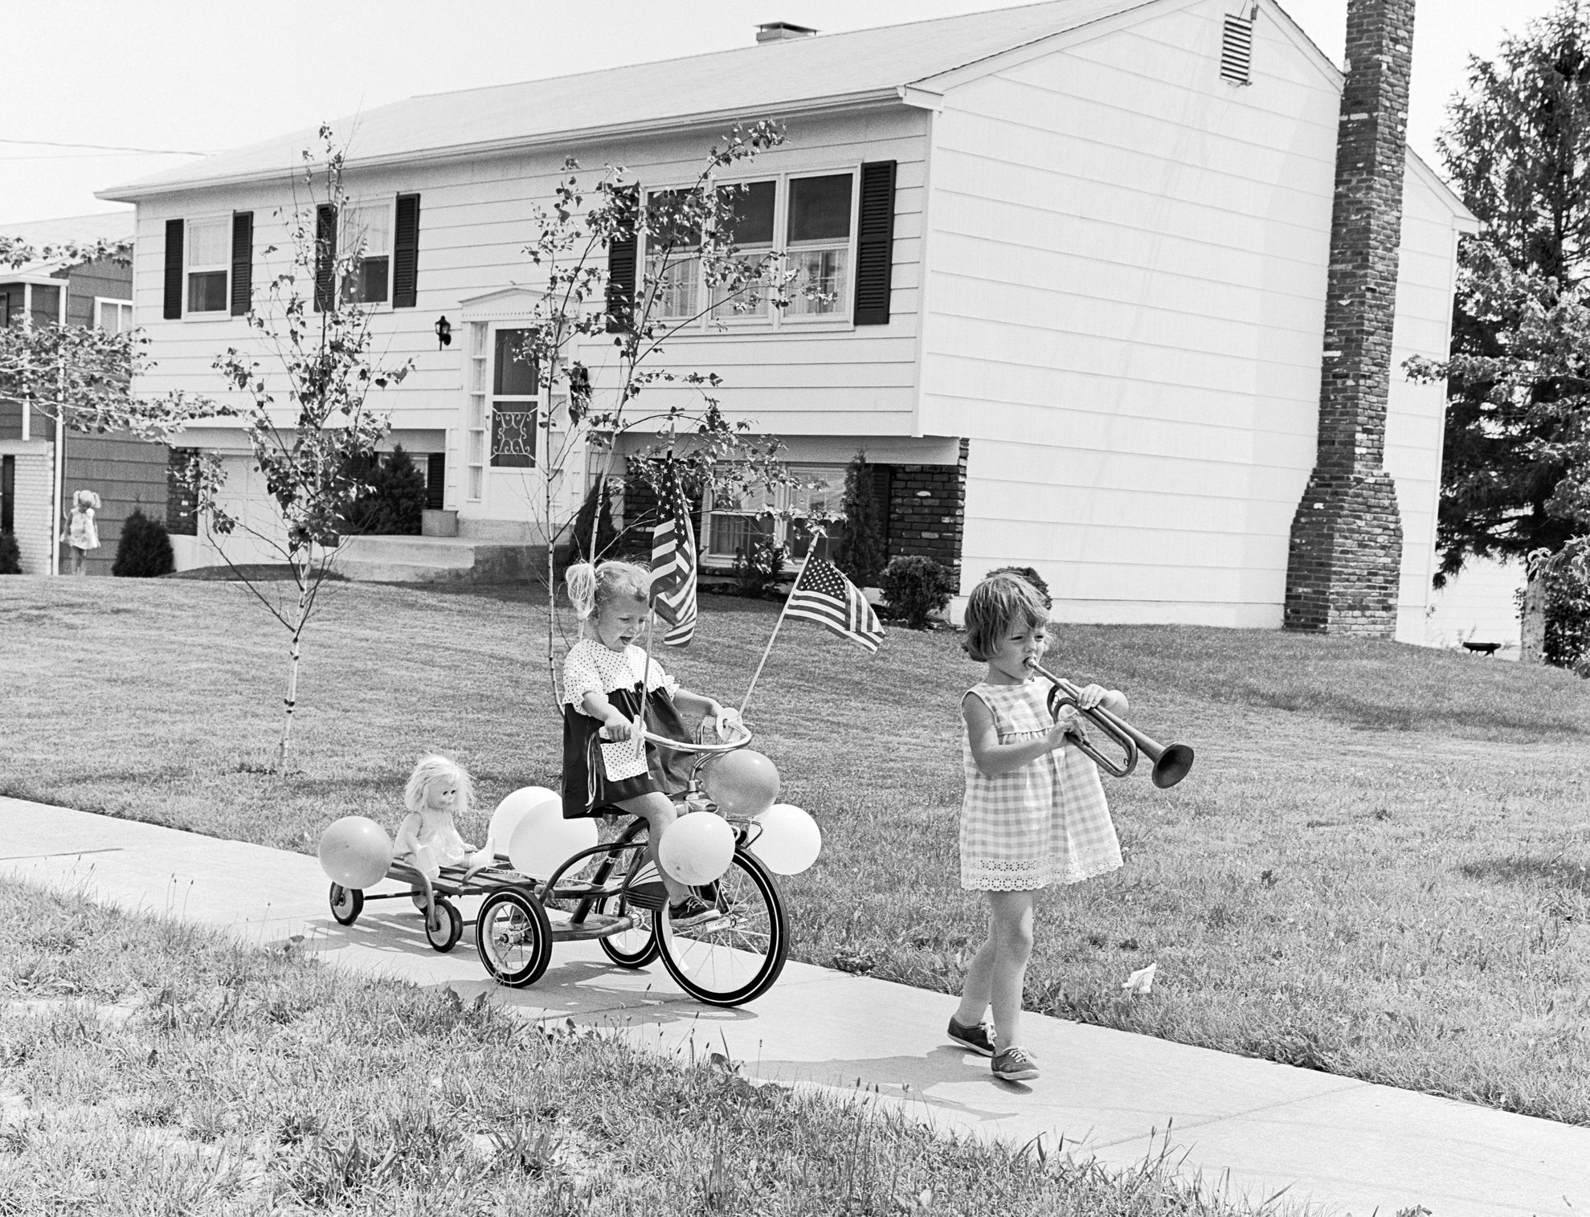
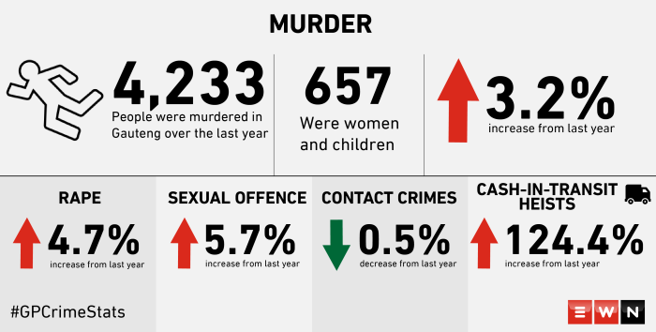
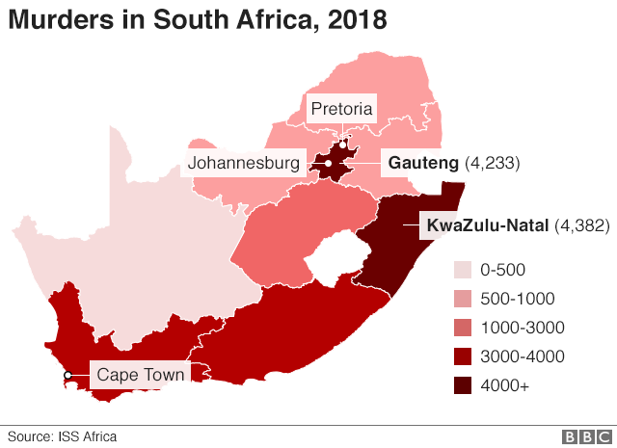

BACKROUND
CRIME
PROPERTY VALUE
SAFE COMMUNITY

Slide 5
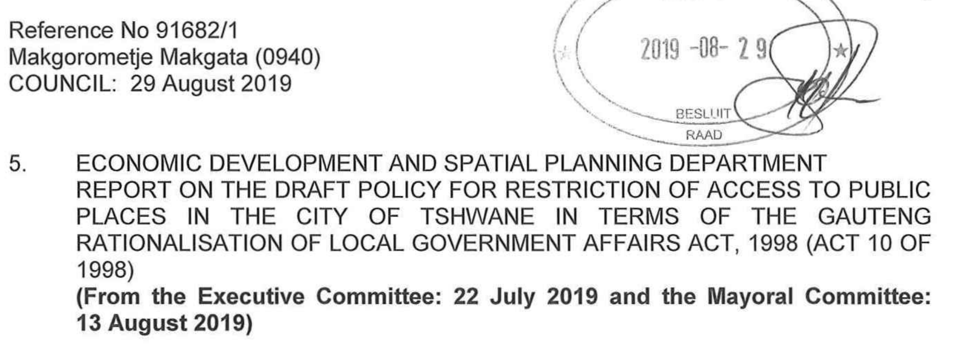
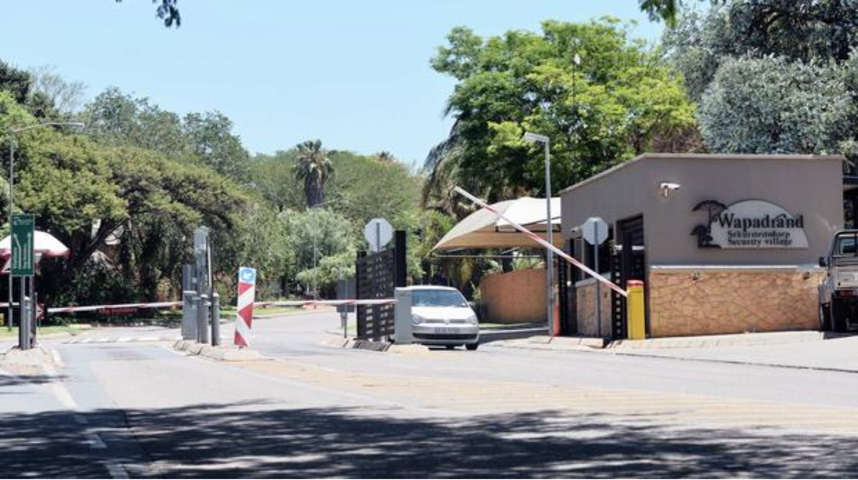
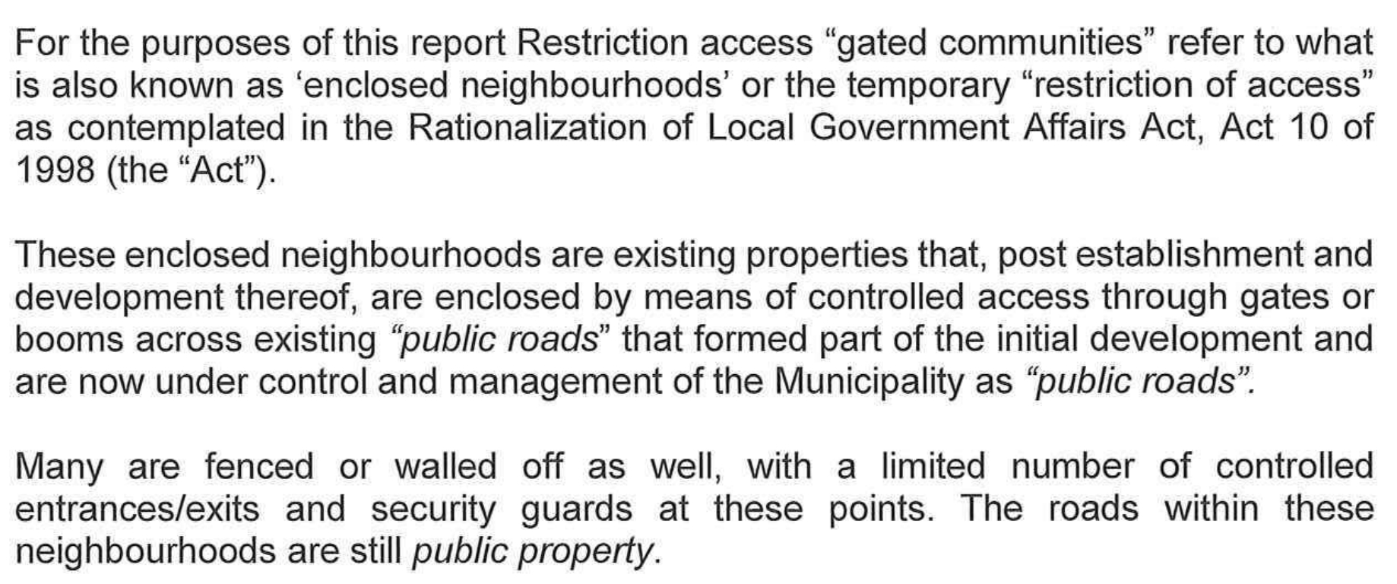
MUNICIPAL
PROCESS
City of Tshwane
Draft Policy for Restriction of Access to Public Places
Definition / Description of “Restriction Access”

Slide 6
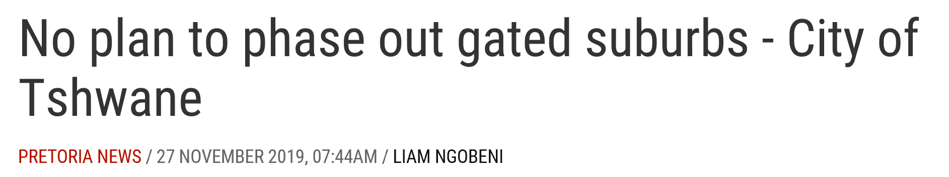
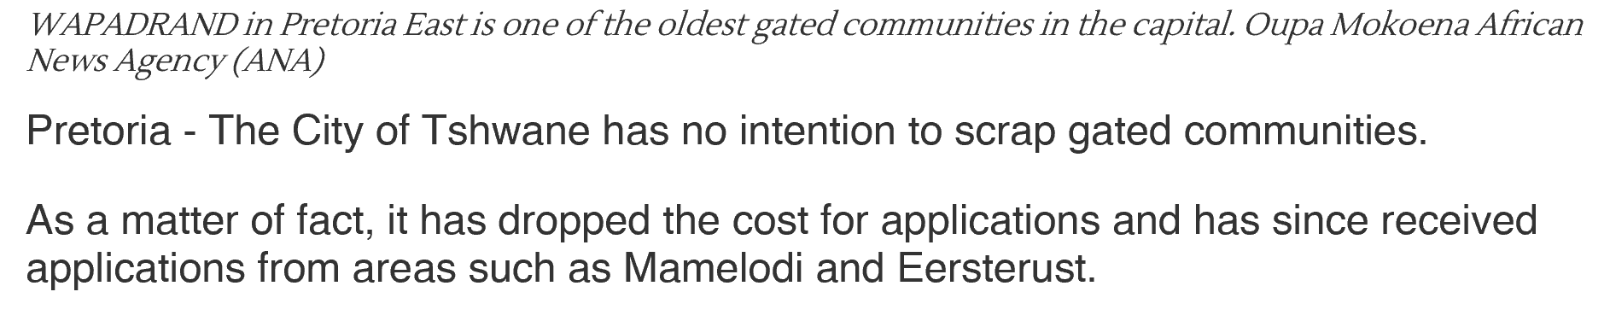
Latest Viewpoint - News
https://www.iol.co.za/pretoria-news/no-plan-to-phase-out-gated-suburbs-city-of-tshwane-38041579

Slide 7
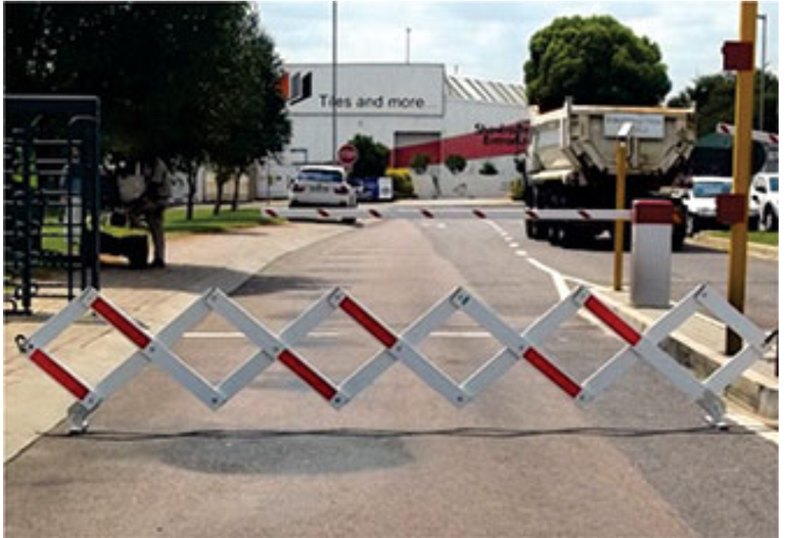
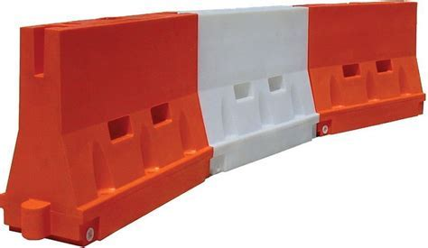
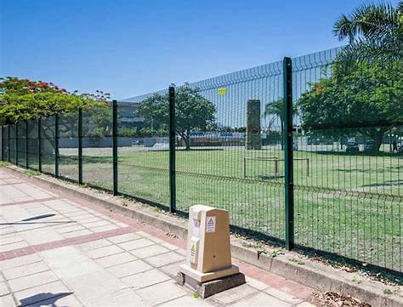
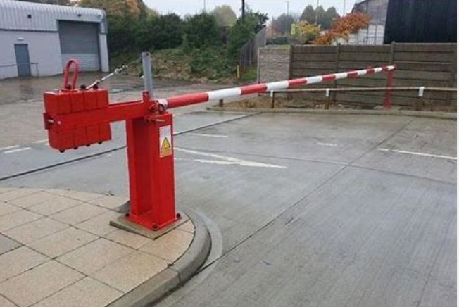
PROPOSED
PROCESS
TEMPORARY INSTALLATION
MUNICIPAL APPLICATION
Clearvu or similar fences and gates
Electronic Booms
Cameras
Immediate Advantages (Reduction in Crime)
Low Cost
Conditioning people

Slide 8
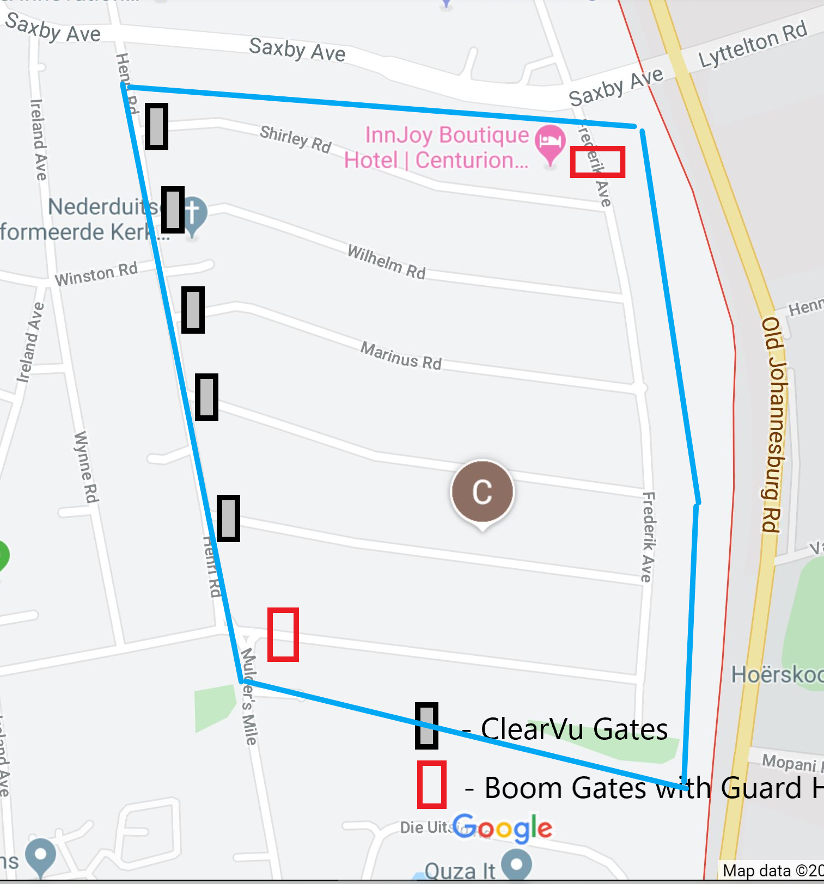
FIRST AREA IDENTIFIED
5 X Gates (Temp Barriers)
1 x Gate at end of Frederik for School Children
2 x Boom Gates

Slide 9

Questionnaire
Getting input from community
Name & Surname, Contact Details?
Do you support the initiative?
Are you willing to contribute to initial CAPEX?
Are you willing to commit to monthly contribution for 24/7 security guards at 2 x boom gates?

Slide 10
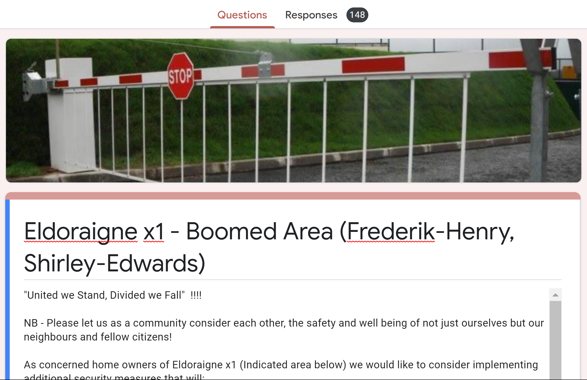
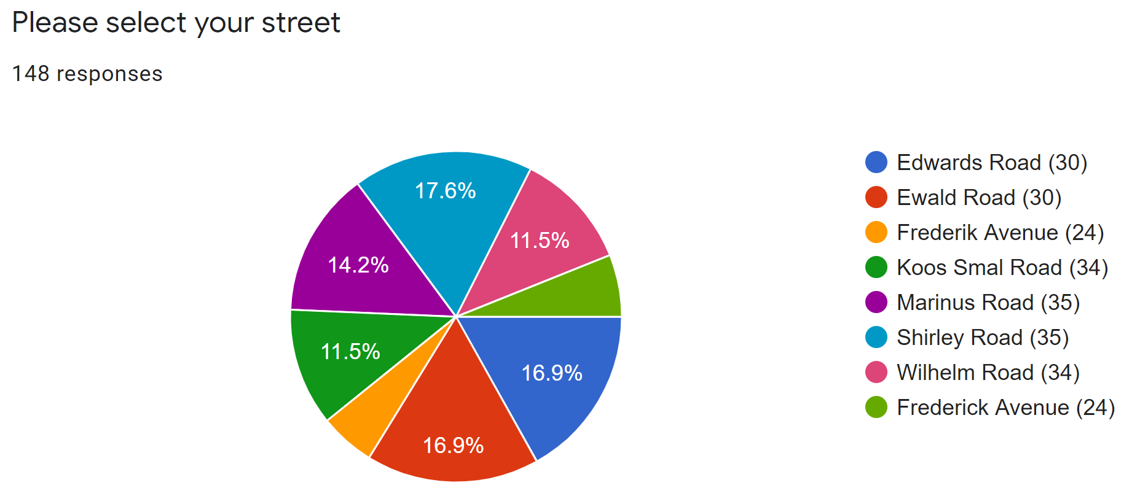
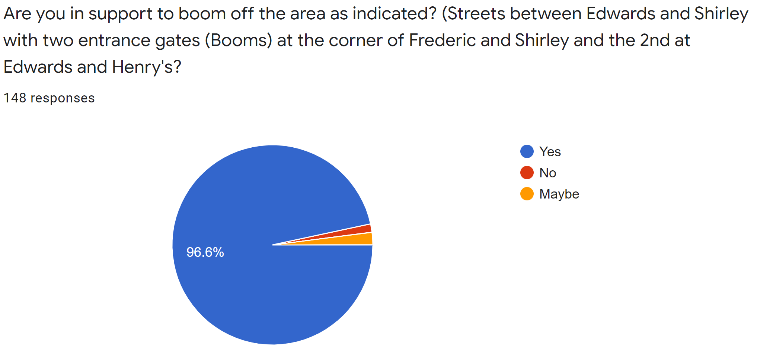
Questionnaire
96,6%
2%

Slide 11
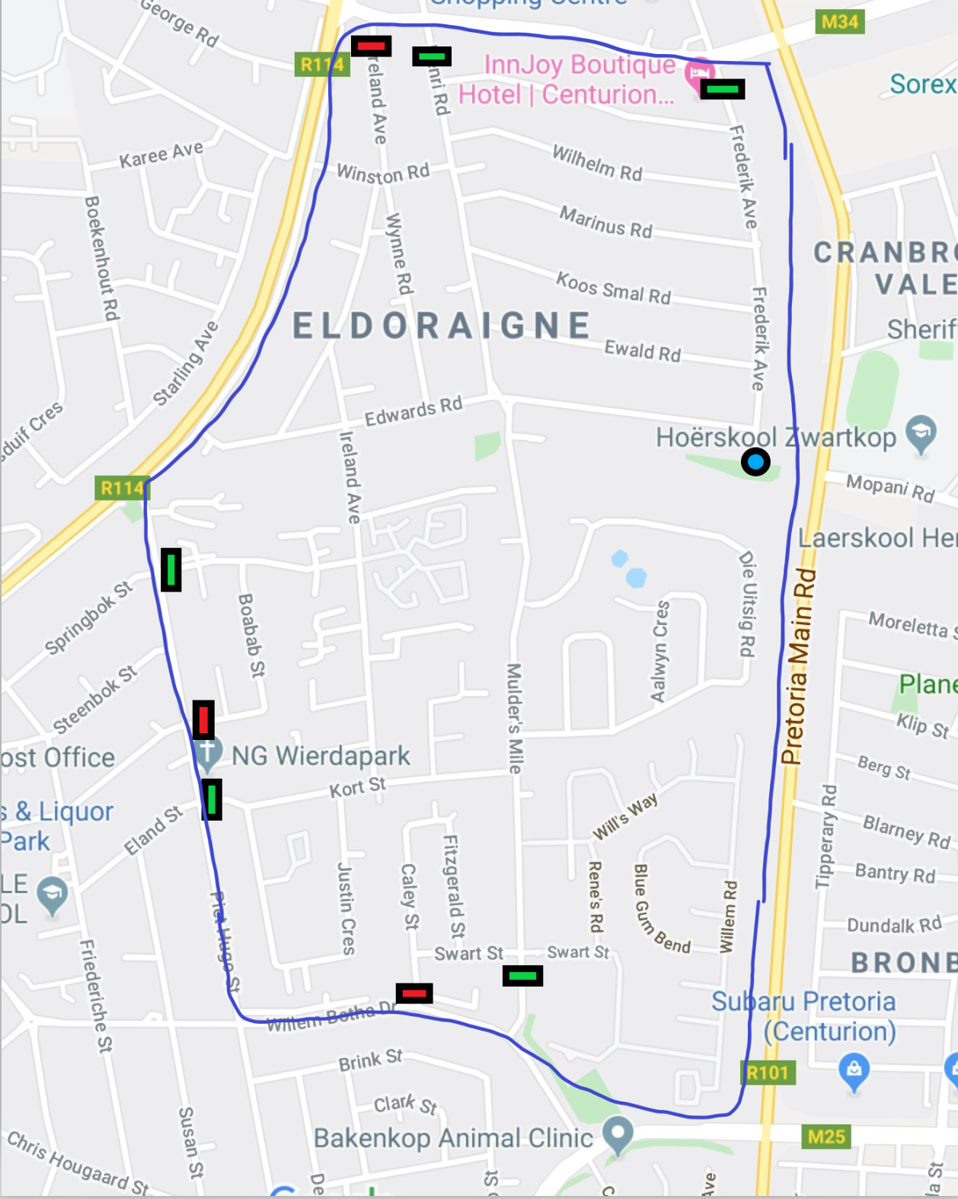
PROPOSED BIGGER AREA
Saxby Road
  Frederik Ave
  Henri Rd
  Ireland Ave
Ruimte Road (R114)
Piet Hugo Street
  Springbok Str
  Boabab St
  Kort St
Willem Botha Drive
  Caley St
  Mulders’s Mile
Old Johannesburg (R101)

Slide 12
PROPOSED NEXT STEPS
Obtain representatives for all streets and complexes (Captains)
Captains to get contact details for all residents (Share Link)
Investigate best options of “Restricted Access” (StreetSafe)
Communication Platforms (WhatsApp, Facebook, Email, etc)
Submit “Official Electronic Form” to vote for support of initiative (Mandate)
Meetings:
  Public Participation
  Vote for committee (Chair, Secretary, Financial, Operational etc)
Finalise strategy (Temp & Perm Solutions, Company Registration, Banking Accounts etc)
Compile scope document for enquiry, adjudication and award

Slide 13
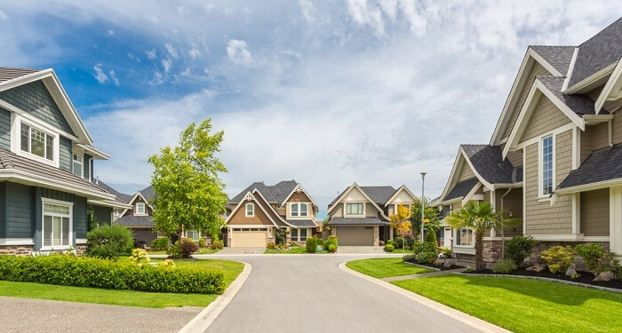
QUESTIONS
Adriaan
Goosen
Phone
081 308 1725
Email
Eldoraigne.adm@gmail.com

